Slide 1
Follow-up after GWAS (expression) quantitative trait loci
MPDI TCII
6th November 2019
Annique Claringbould
FrankeSwertzLab
University Medical Center Groningen
@AnniqueC

Slide 2

GWAS associations over time
Notes:
Over the last 13 years, GWAS hits have been identified for numerous complex traits and diseases, and we identify increasingly more still every month.

Slide 3
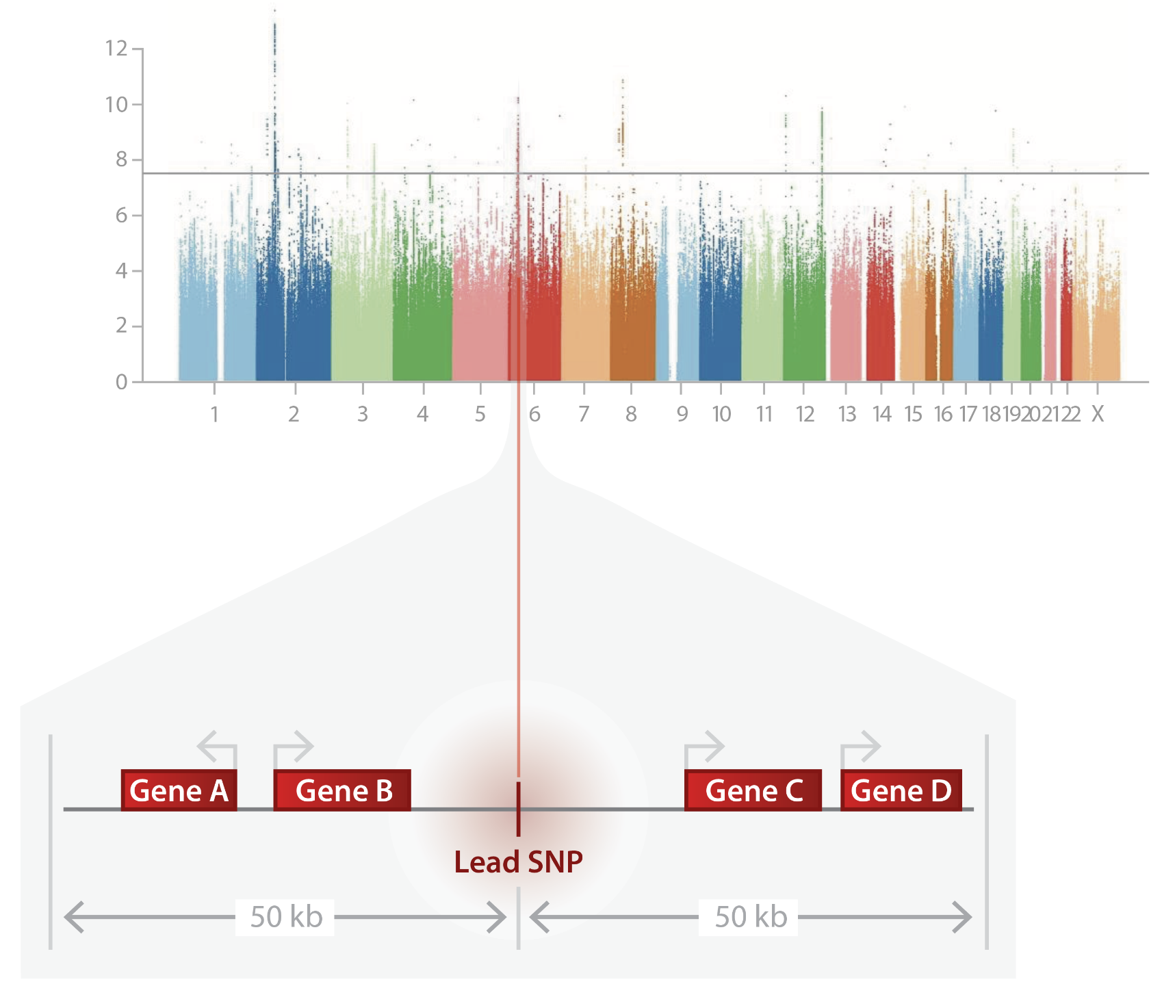
GWAS variants are often located between genes

Slide 4
Causal variant
GWAS variant
Affected gene
Biological function

Slide 5


Slide 6
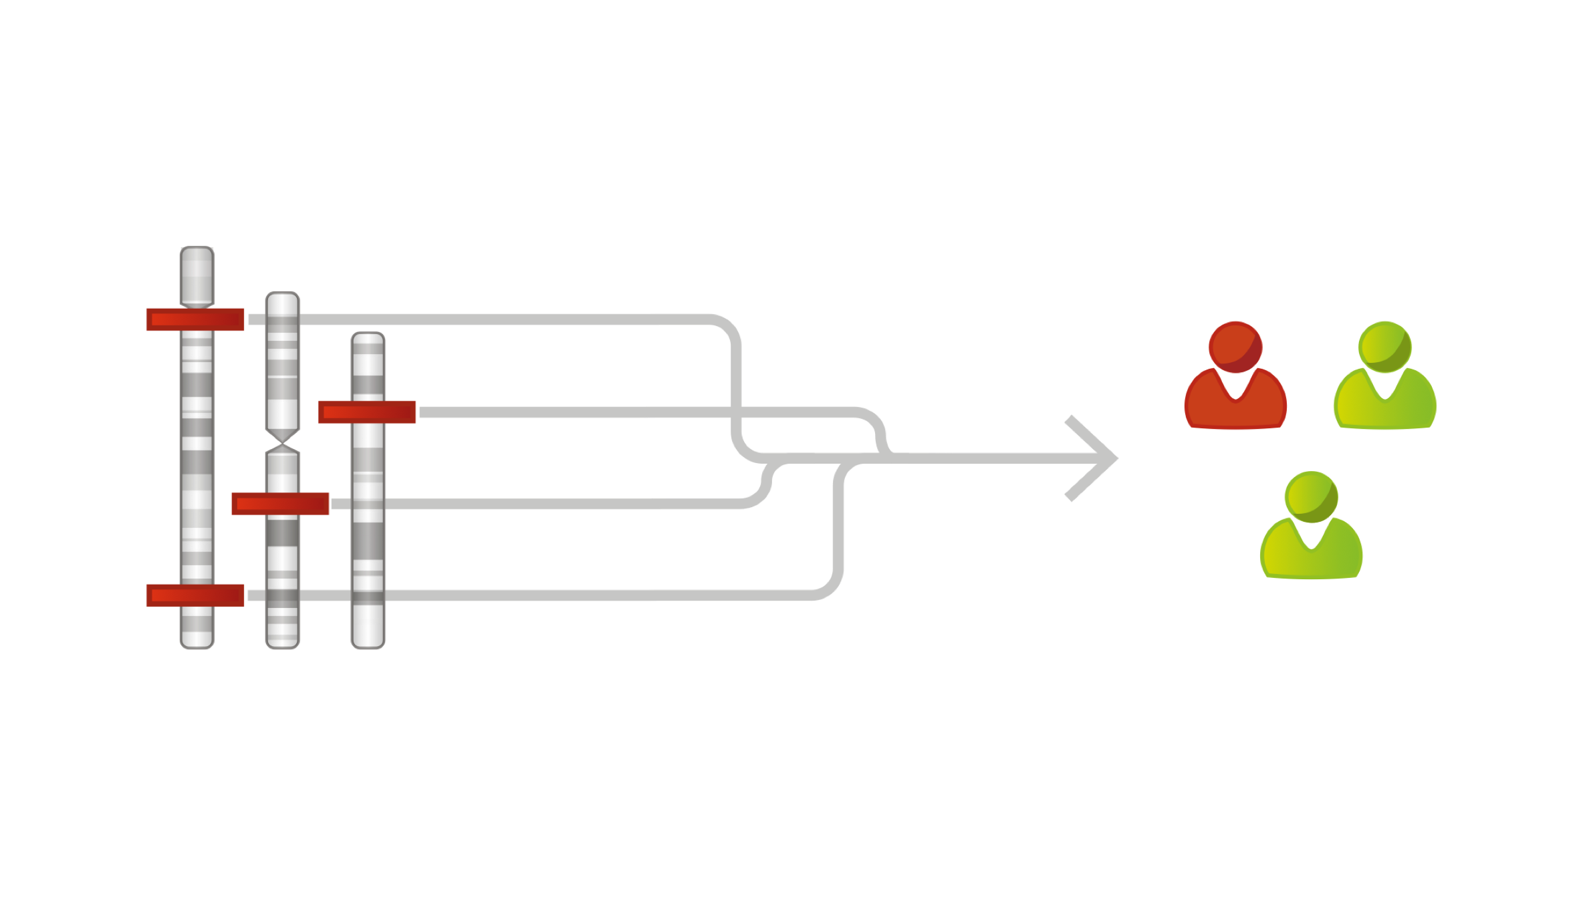
How do GWAS variants contribute to traits?
Genetic variants
Trait
Notes:
However, it often remains unclear if and how these genetic variants influence the development of these complex traits.

Slide 7
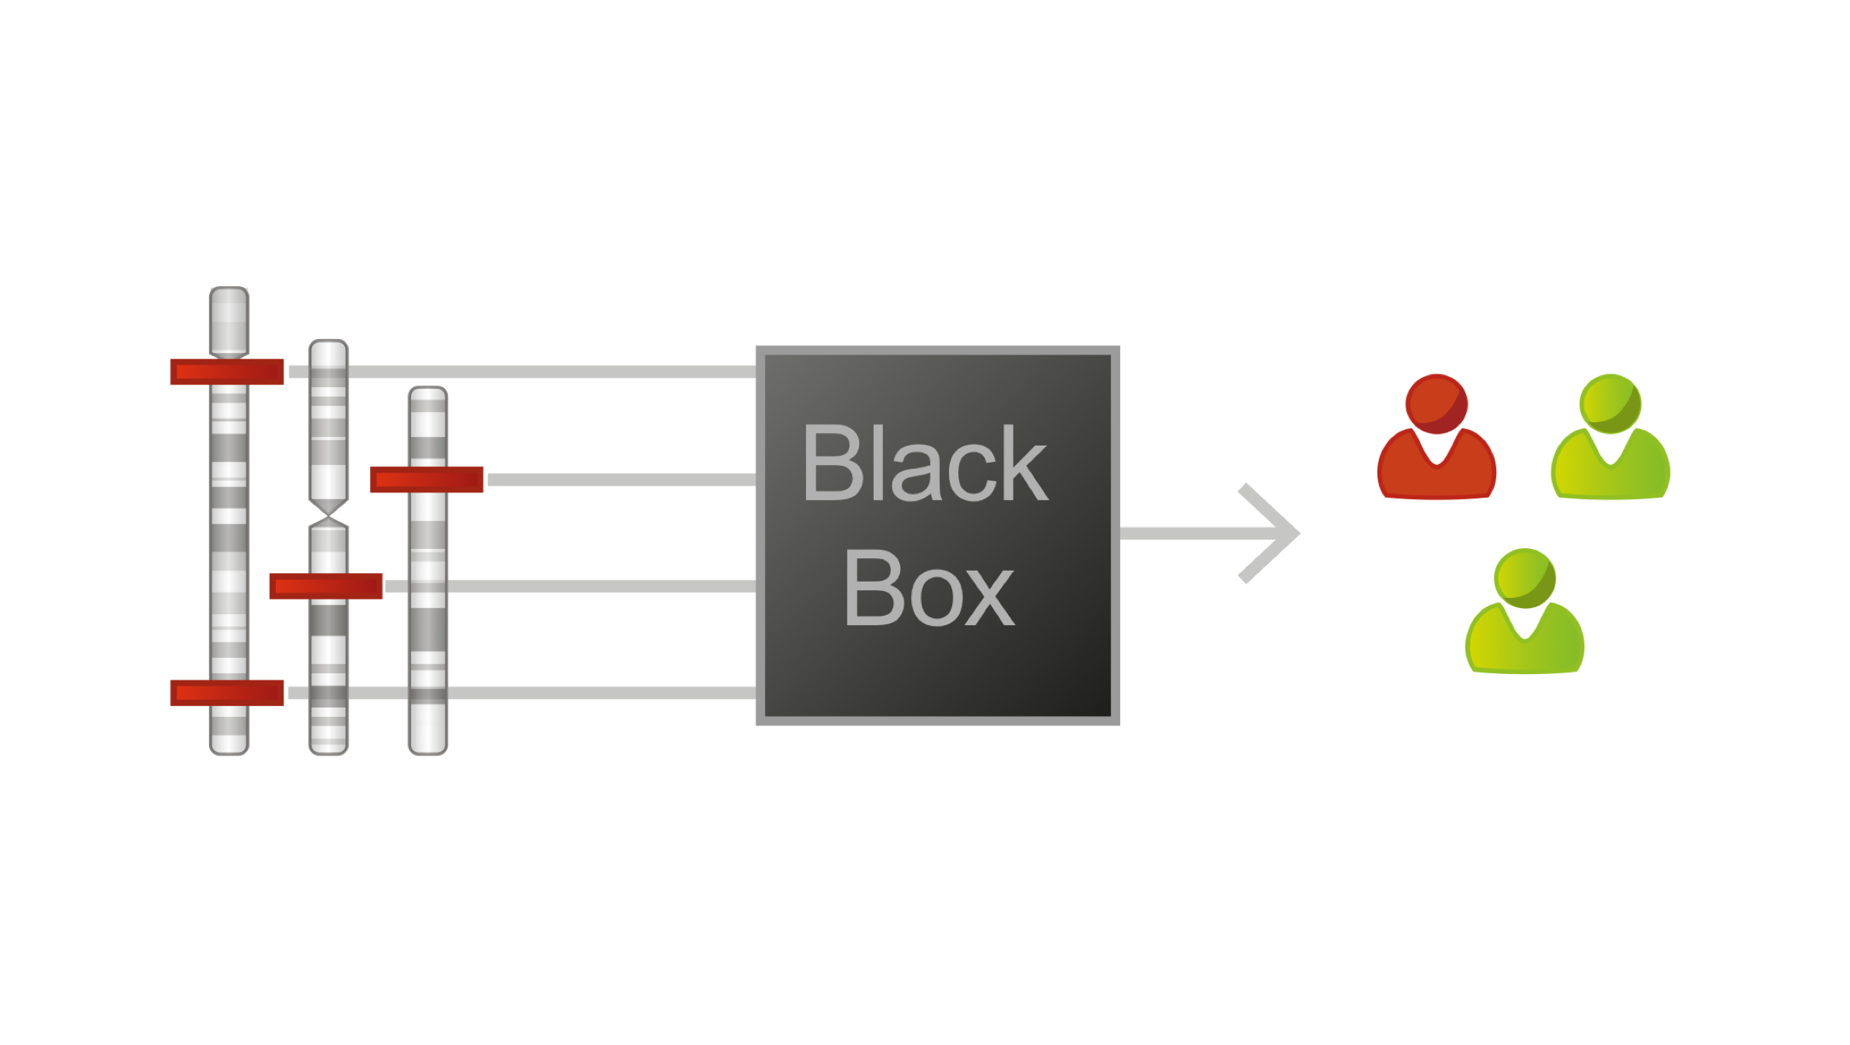
How do GWAS variants contribute to traits?
Genetic variants
Trait
Notes:
To gain more insight in the biological mechanisms behind these associations, the genetics community has been trying to link GWAS variants to genes that would influence the trait.
An early approach to link SNPs to genes was to take the closest gene to the SNP. However, many variants are not directly within or near genes, or there might be a big number of genes nearby.

Slide 8
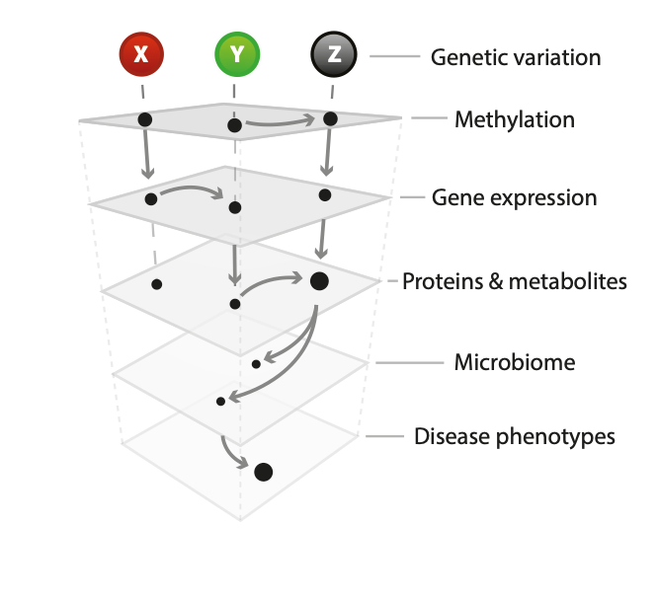

Slide 10
Moving from variants to genes using eQTLs
eQTL = expression quantitative trait locus
Most GWAS hits do not change protein structure
They often do affect expression levels
Genetic variation correlated to expression

Slide 11
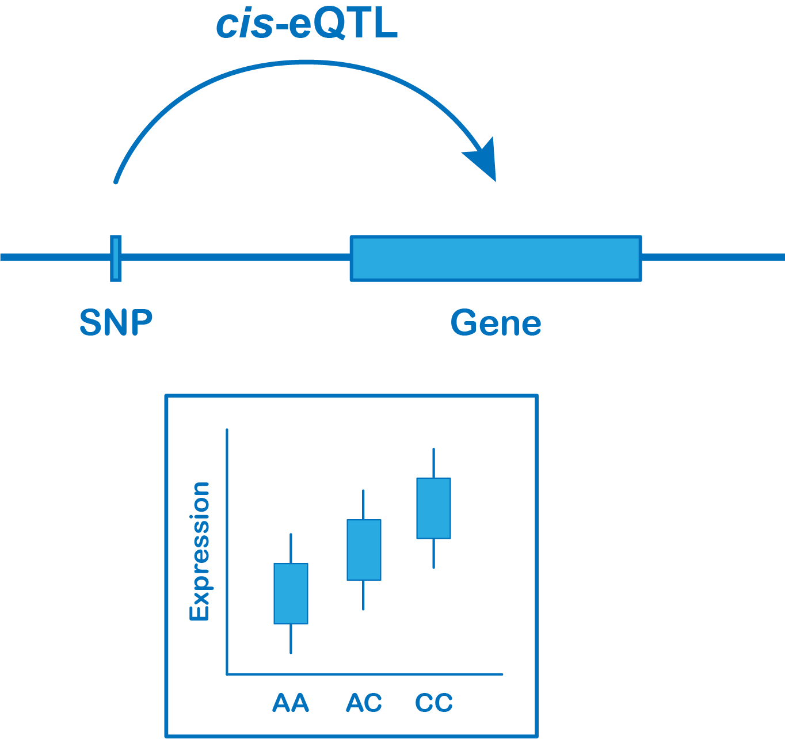
Expression Quantitative Trait Locus
expression quantitative trait locus
molecular data layer
phenotype with continuous measure
small part of the genome
Notes:
So when we speak about an ‘eQTL’: we mean the combination of a genetic variant and the gene who’s expression is affected by the genotype at that SNP location

Slide 12
eQTL dataset
Genotypes
Expression levels
Variant | Sample1 | Sample2 | Sample3
SNP 1 | A/A | A/T | T/T
SNP 2 | T/T | T/T | T/C
SNP 3 | G/C | G/C | G/G
SNP 4 | G/G | G/G | G/G
Gene | Sample1 | Sample2 | Sample3
Gene 1 | 10 | 20 | 30
Gene 2 | 20 | 10 | 18
Gene 3 | 10 | 11 | 12
Gene 4 | 10 | 10 | 10

Slide 13
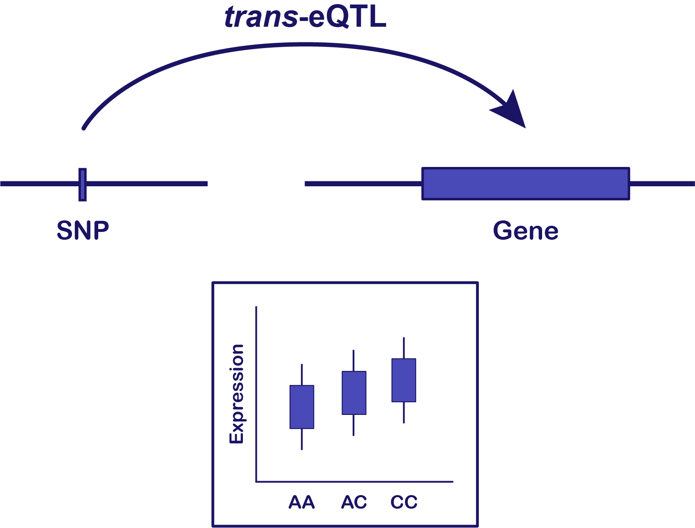
Cis- and trans-eQTLs
Notes:
For cis you look only at the genes that lie very nearby the SNP.
For any SNP that may be a few up to a a hundred genes.
In the whole genome, there are some ~20,000 genes.
For trans, you look at the combination of a SNP with every one of those genes!

Slide 14
Multiple testing in eQTL analyses
Normally we say p-value 0.05 is significant
5% (1/20) chance that a result is a false positive
Suppose we perform 20 tests
When using p-value cut-off of 0.05, we expect 1 false positive
Cis-eQTL mapping: 10,000 SNPs x 20 genes = 200,000 tests
Trans-eQTL mapping: 10,000 SNPs x 20,000 genes = 200,000,000 tests

Slide 15
False discovery rate (FDR)
Expected fraction of false positives results
Determine p-value cut-off that would result in a FDR of 0.05
How do you know what false positives to expect?
Permutations
Notes:
One of the solutions when doing a lot of tests is to look at FDR

Slide 16
Permutations in eQTL analysis: mix up the labels
Genotypes
Expression levels
Variant | Sample1 | Sample2 | Sample3
SNP 1 | A/A | A/T | T/T
SNP 2 | T/T | T/T | T/C
SNP 3 | G/C | G/C | G/G
SNP 4 | G/G | G/G | G/G
Gene | Sample2 | Sample3 | Sample1
Gene 1 | 10 | 20 | 30
Gene 2 | 20 | 10 | 18
Gene 3 | 10 | 11 | 12
Gene 4 | 10 | 10 | 10
Notes:
One of the solutions when doing a lot of tests is to look at FDR

Slide 17
FDR using permutations
Try to find eQTLs based on the ‘wrong’ (permuted) dataset
Due to the many tests, you will identify some eQTLs
Look at the p-value for the most significant fake eQTLs
Determine p-value cut-off for the real data that would result in a maximum of 5% of the results equally significant as the fake eQTLs
Notes:
One of the solutions when doing a lot of tests is to look at FDR

Slide 18
eQTLGen Consortium
31,684 individuals
Expression data from blood
19,960 genes
1000G
SNPs imputed to 1000G reference
10,317 trait-associated variants
Integration of RNA-seq and microarray data
Notes:
For this reason, we set up the eQTLGen Consortium, where we use data from almost 32K individuals to identify eQTLs. We tested almost 20K genes that are expressed in blood. The SNPs were imputed to the 1000G reference panel, and we specifically looked at 10K trait-associated variants for the trans-eQTL analyses. We integrated microarray and RNA-seq data to achieve the biggest sample size.

Slide 19
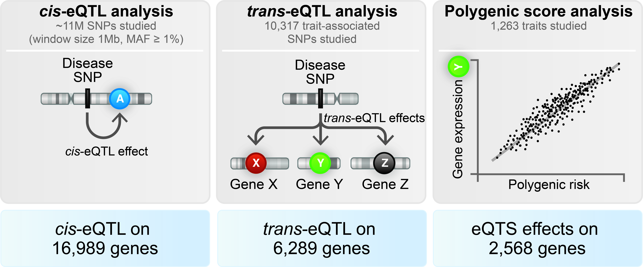
cis-eQTL results
Võsa et al., bioRxiv (2018)
Notes:
First, I’d like to go through some of the local gene regulation observations. We identified cis-eQTLs for almost 17K genes.

Slide 20
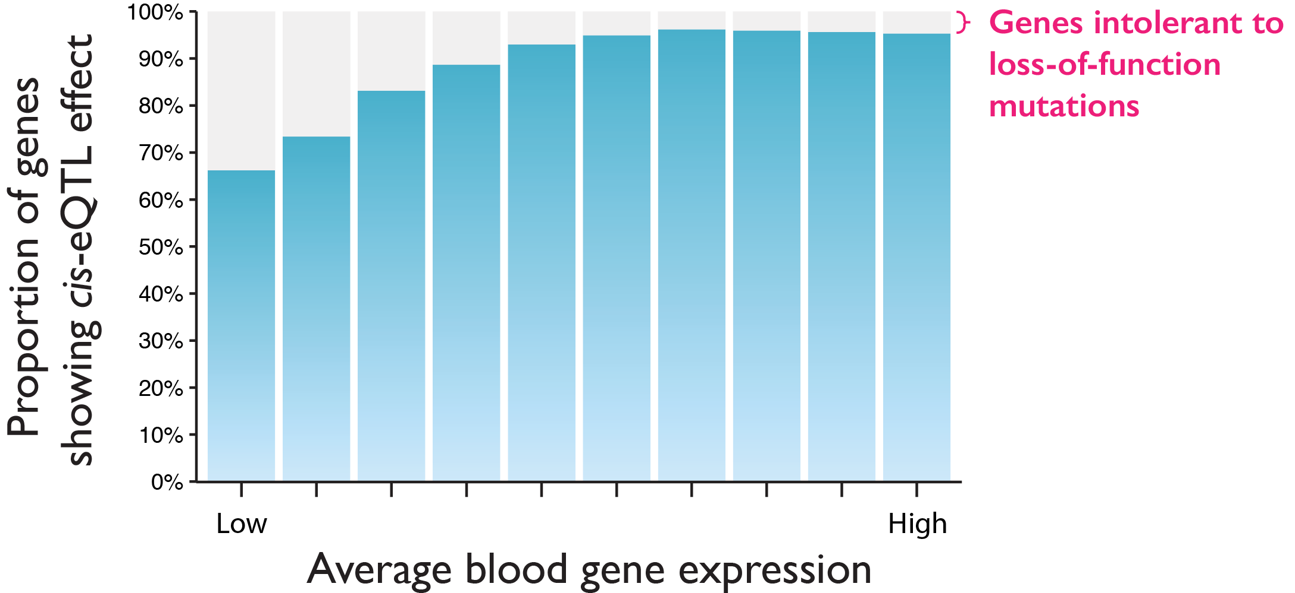
Almost all genes are regulated by a local genetic variant
Võsa et al., bioRxiv (2018)
Notes:
That means that we observe cis-eQTLs for the large majority of all genes that are expressed in blood, as you can see in blue in this plot. It is clear that we have reached a plateau with calling eQTLs for highly expressed genes. What’s interesting is that there is also a small proportion of highly expressed genes that has no eQTLs. We hypothesised that these genes must play an important role in cellular function if they cannot be regulated by common variation, and that is supported by the fact that these genes also have a much higher probability of being intolerant to loss-of-function mutations.
pLI genes involved in RNA processing

Slide 21
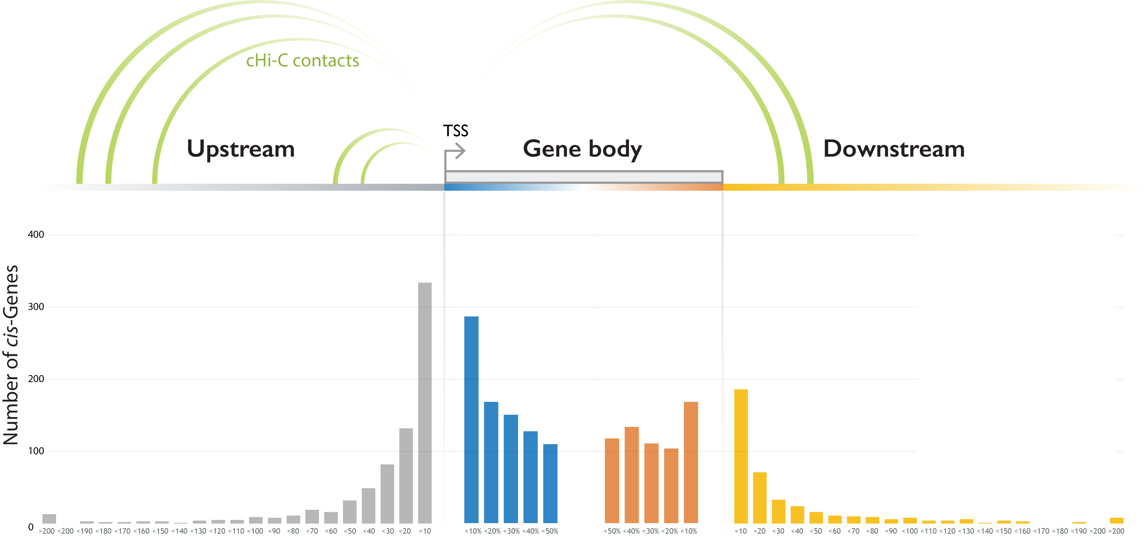
Cis-eQTL top SNPs are almost always near gene
97% of the strong cis-eQTL SNPs maps within 100kb of the gene
Notes:
Next we wanted to see where the top SNP per gene was located. We used a threshold of 1Mb, but this plot shows that the majority of top cis-eQTL SNPs were within or very close to the gene.
Of course, there were also SNPs that mapped much further away, but we found that this could often be explained by the physical contact between the SNP and gene, as measured by capture Hi-C.
So now that we have a sense of the ubiquity and location of these cis-eQTLs, we assumed we would be able to ‘annotate’ many well-known GWAS hits, and add some insight there.

Slide 22
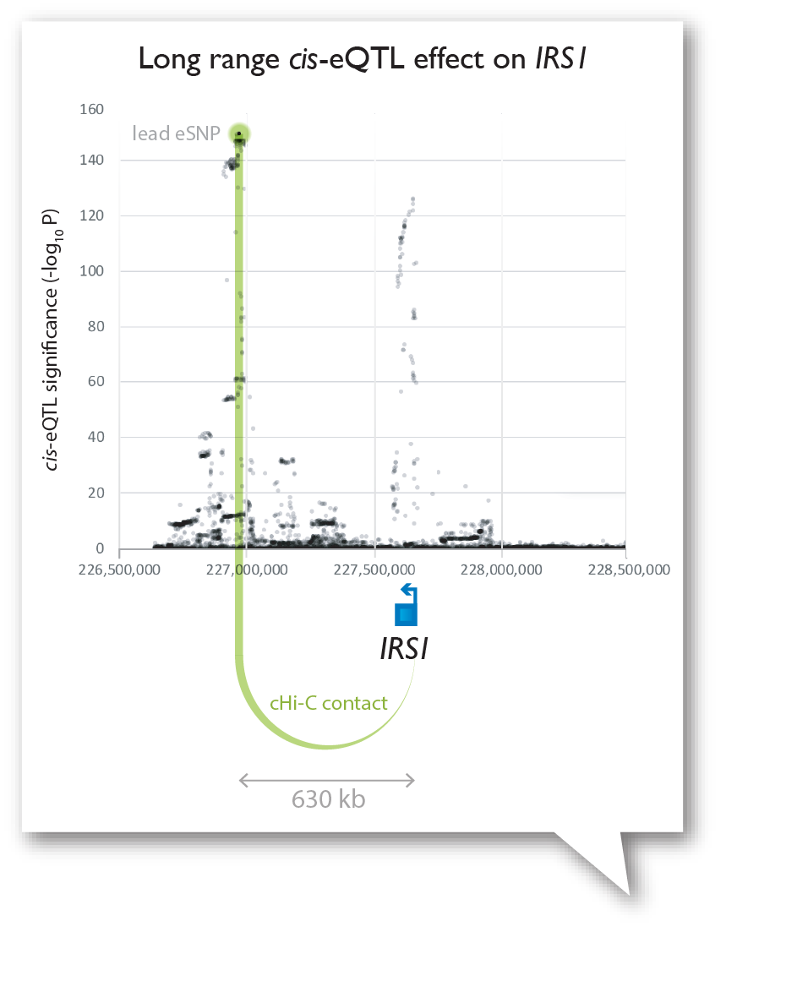
Cis-eQTL top SNPs are almost always near gene
Notes:
Next we wanted to see where the top SNP per gene was located. We used a threshold of 1Mb, but this plot shows that the majority of top cis-eQTL SNPs were within or very close to the gene.
Of course, there were also SNPs that mapped much further away, but we found that this could often be explained by the physical contact between the SNP and gene, as measured by capture Hi-C.
So now that we have a sense of the ubiquity and location of these cis-eQTLs, we assumed we would be able to ‘annotate’ many well-known GWAS hits, and add some insight there.

Slide 23
Detecting independent eQTLs
1 .Regress out the effect of the top SNP
2. Run secondary eQTL mapping on residual expression
Zhernakova et al., Nature Genetics (2016)
Notes:
In this way weaker secondary effects can be found
We repeat

Slide 24
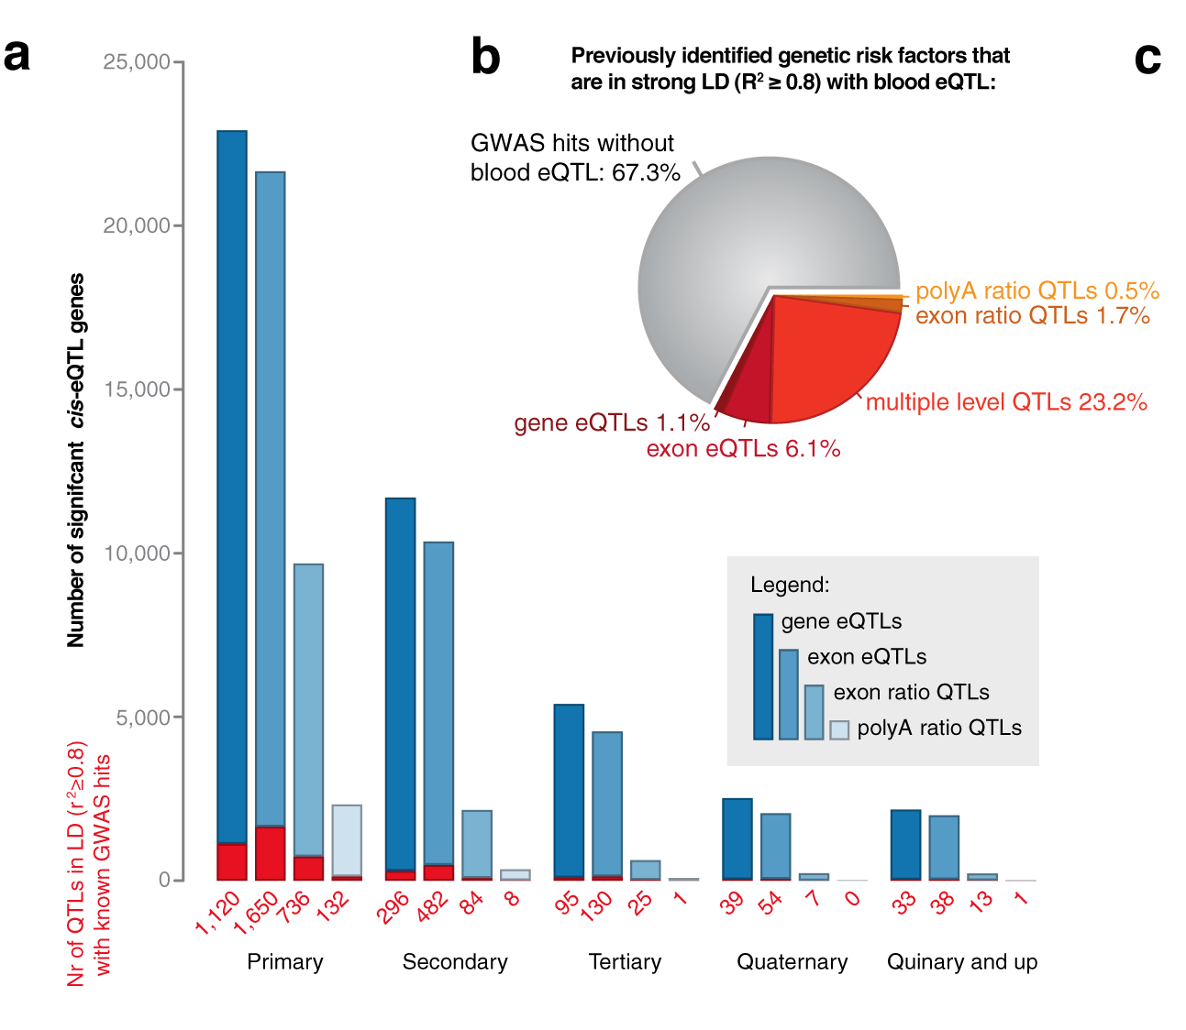
Many genetic risk factors affect gene expression
Zhernakova et al., Nature Genetics (2016)

Slide 25
trans-eQTL results
Notes:
We think that trans-eQTLs could be more useful, because they reflect the downstream consequences of these genetic variants. As expected, because of the smaller effect sizes, we observed trans-eQTLs on a smaller number of genes, some 6,000.

Slide 26
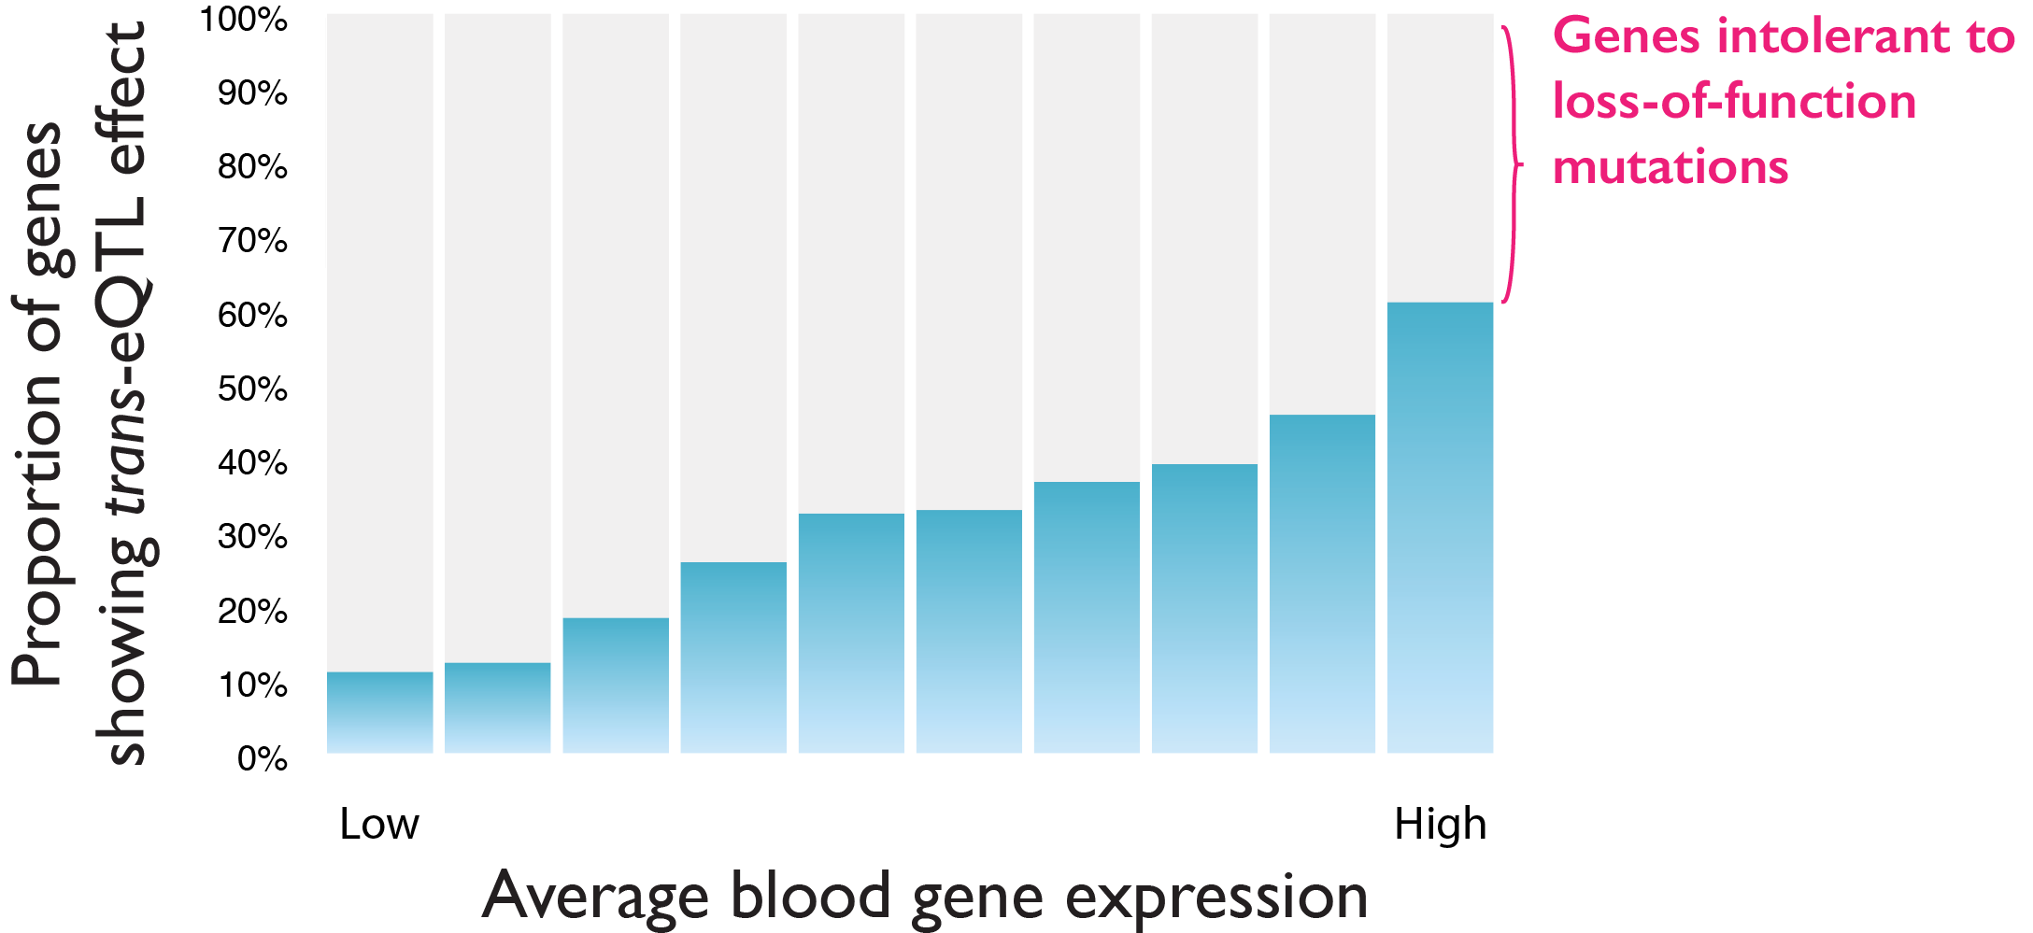
Detection of trans-eQTLs depends on expression level
Võsa et al., bioRxiv (2018)
Notes:
We can also tell that we have not nearly reached the plateau that we saw for cis-eQTLs. More highly expressed genes are more likely to be a trans-eQTL, and the detection still depends on that. So we were quite surprised that the same pattern for ‘eQTL intolerant’ genes can be seen here.

Slide 27
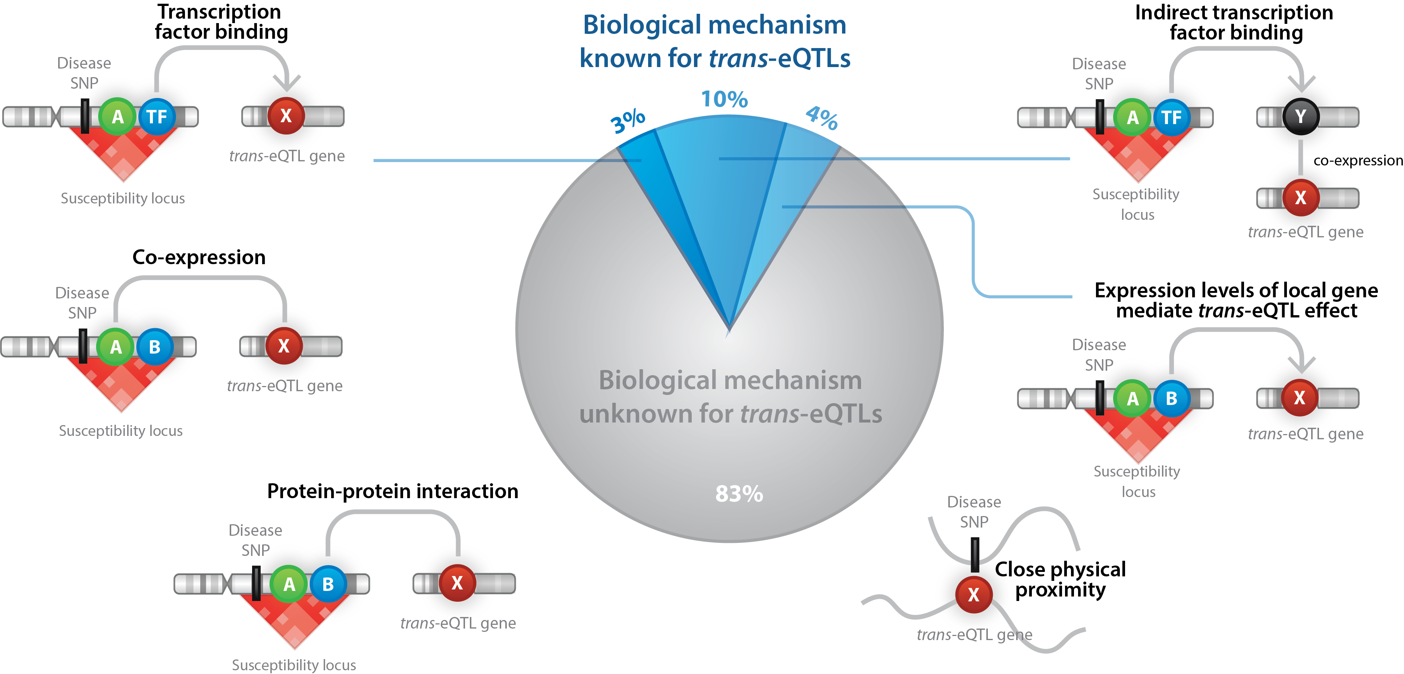
Mechanisms of trans-eQTLs
Võsa et al., bioRxiv (2018)
Notes:
Of course the next question that people always ask is how these trans-eQTLs come about. What are the mechanisms that could cause these associations to arise? We’ve tested a number of mechanisms, ranging from transcription factor binding to protein-protein interactions and physical proximity. We estimated that we can explain the mechanism for a maximum of 17% of all trans-eQTLs. That’s a good start, but we wonder what else could there be going on? If you have any ideas, please bring them up in the discussion. Despite not knowing the mechanisms for a large number of trans-eQTLs, sometimes we can ﻿combine cis- and trans-eQTL effects to pinpoint the genes acting as drivers of trans- eQTL effects.

Slide 28
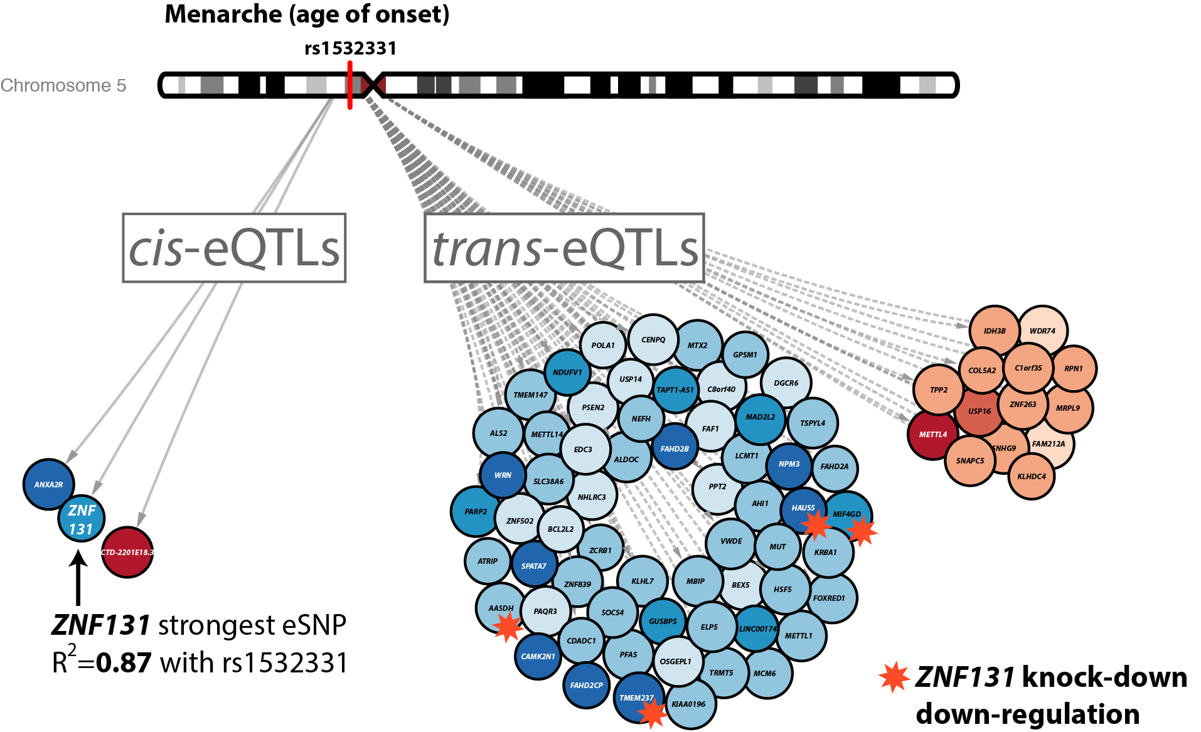
Trans-eQTLs can point to biological mechanisms
Võsa et al., bioRxiv (2018)
Notes:
For example, an age of menarche SNP has an effect on three cis genes and many trans genes. One of the three local genes, ZNF131, is known to affect gene expression of other genes. In a knock-down experiment, downregulation of ZNF131 resulted in downregulation of four genes that we can all find back in the same direction in our trans-eQTL results. This example illustrates that looking at downstream observations can actually help us better understand what genes are important locally.
﻿ZNF131 has been hypothesized to inhibit estrogen signaling, which may explain how the SNP in this locus contributes to altering the age of menarche. But ideally, we’d want to know how many GWAS traits can be better interpreted using trans-eQTLs.

Slide 29
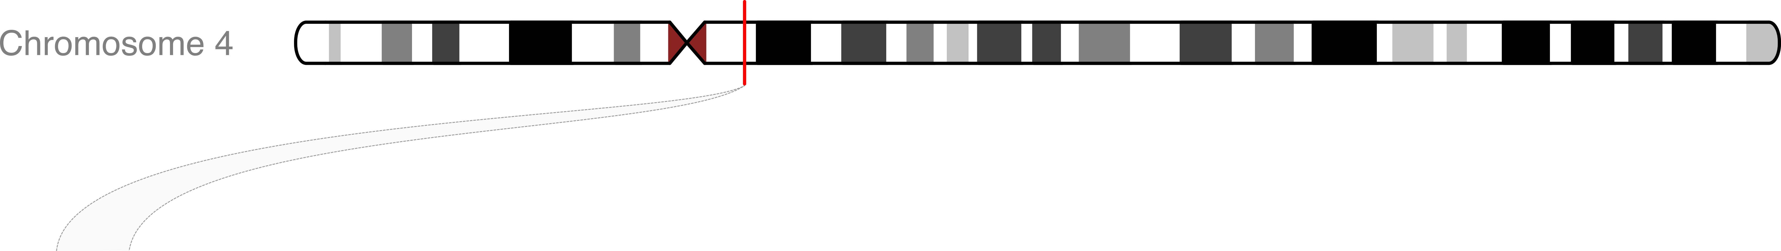
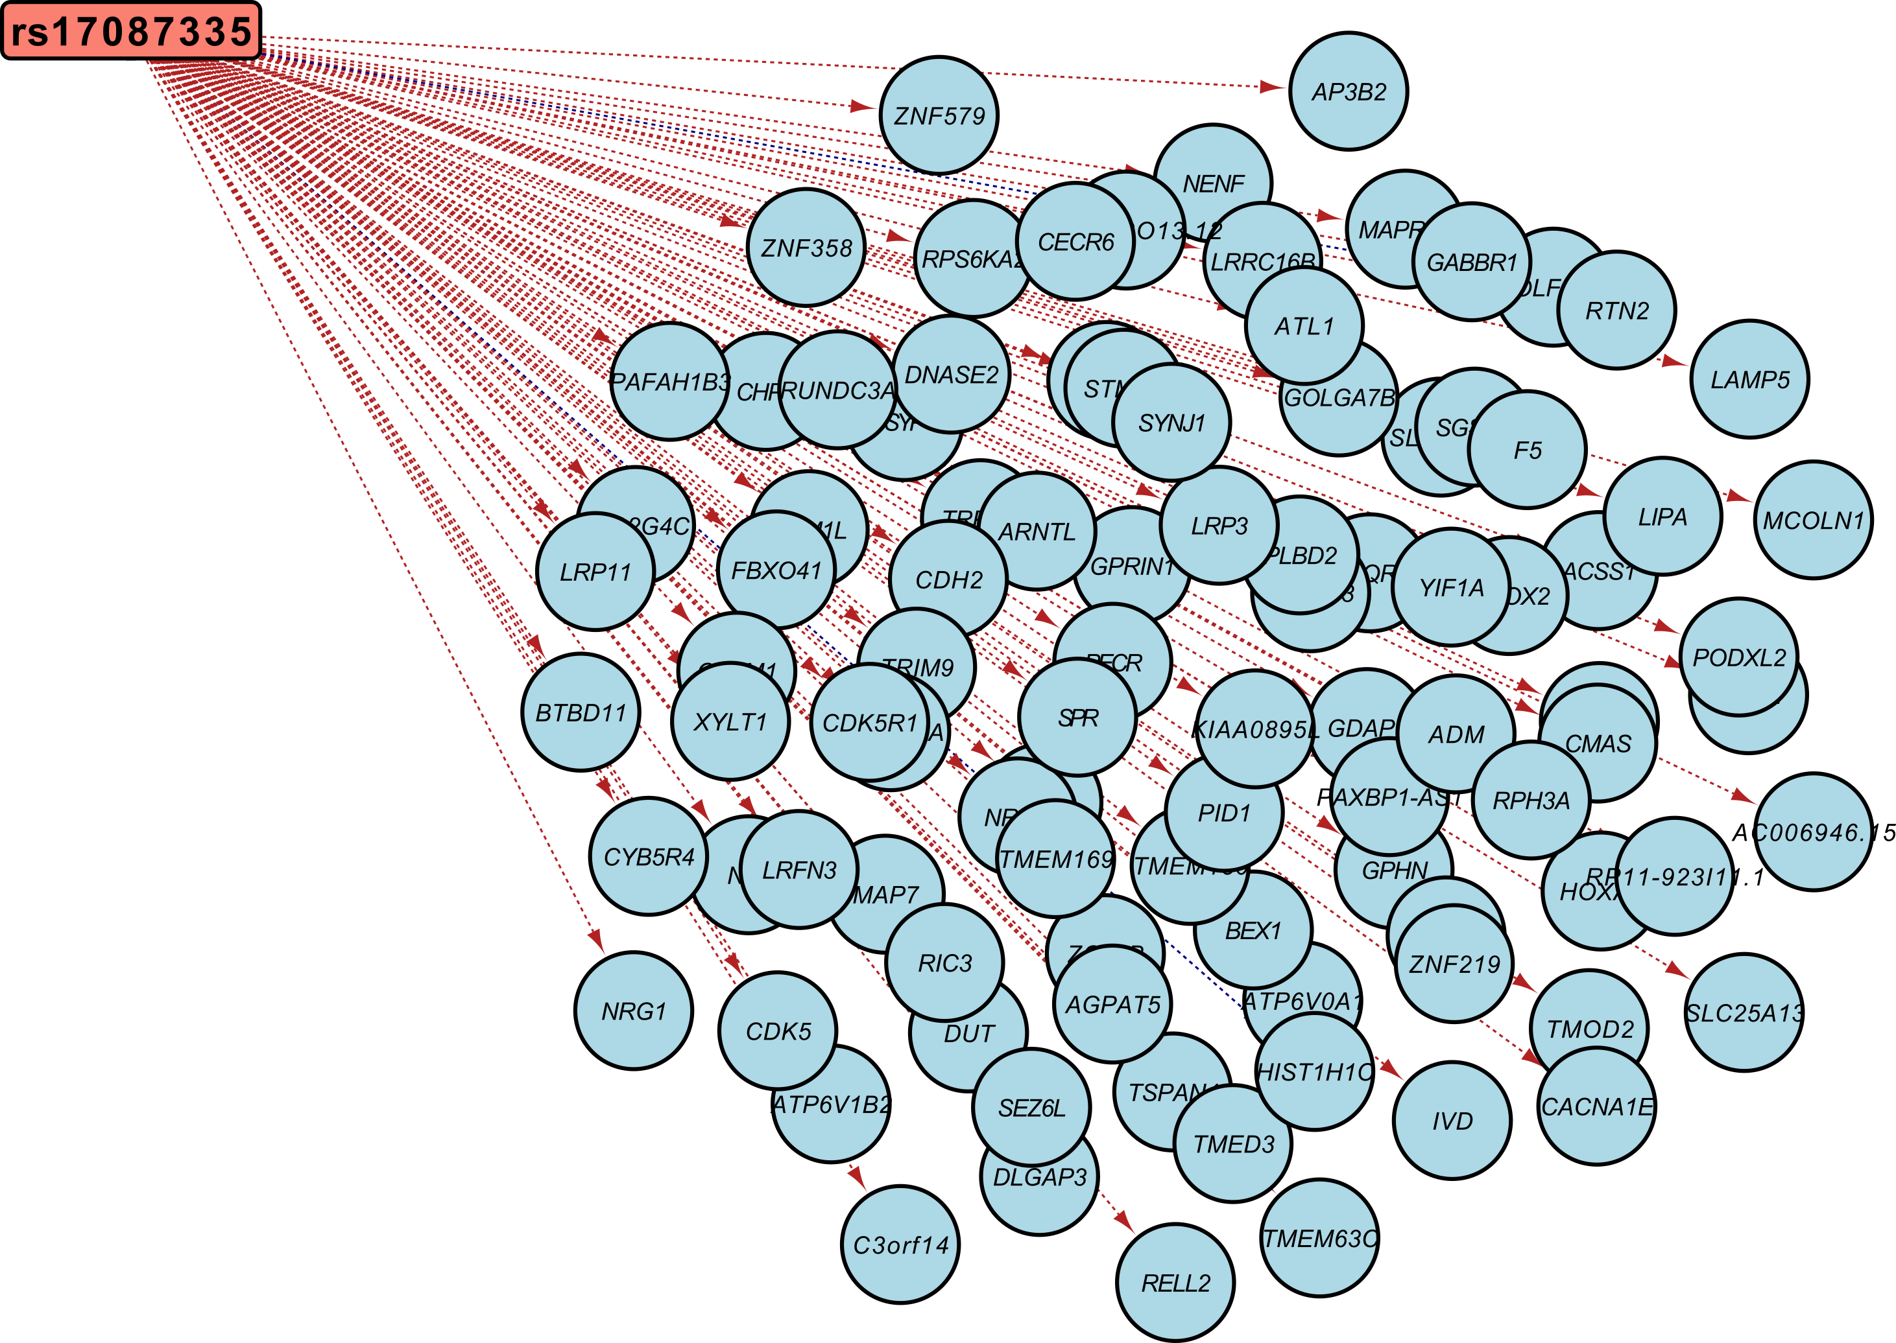
Trans-eQTLs can point to biological mechanisms
rs17087335
trans: 98%

Slide 30
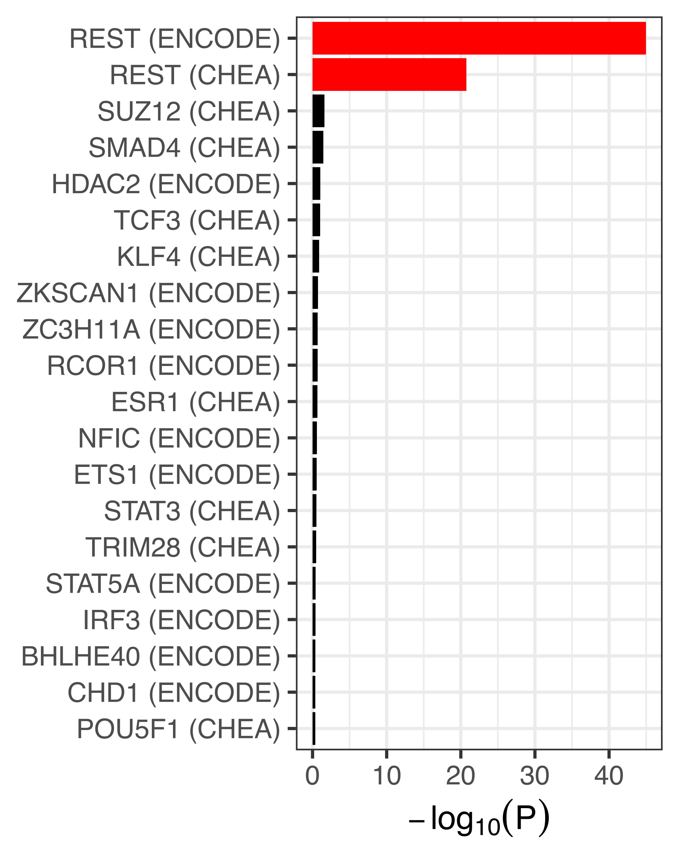
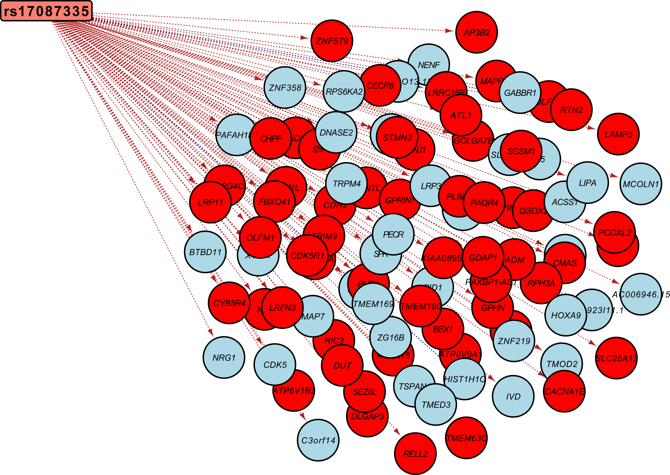
REST locus in Coronary Artery Disease
Trans-eQTLs can point to biological mechanisms
rs17087335
trans: 98%

Slide 31
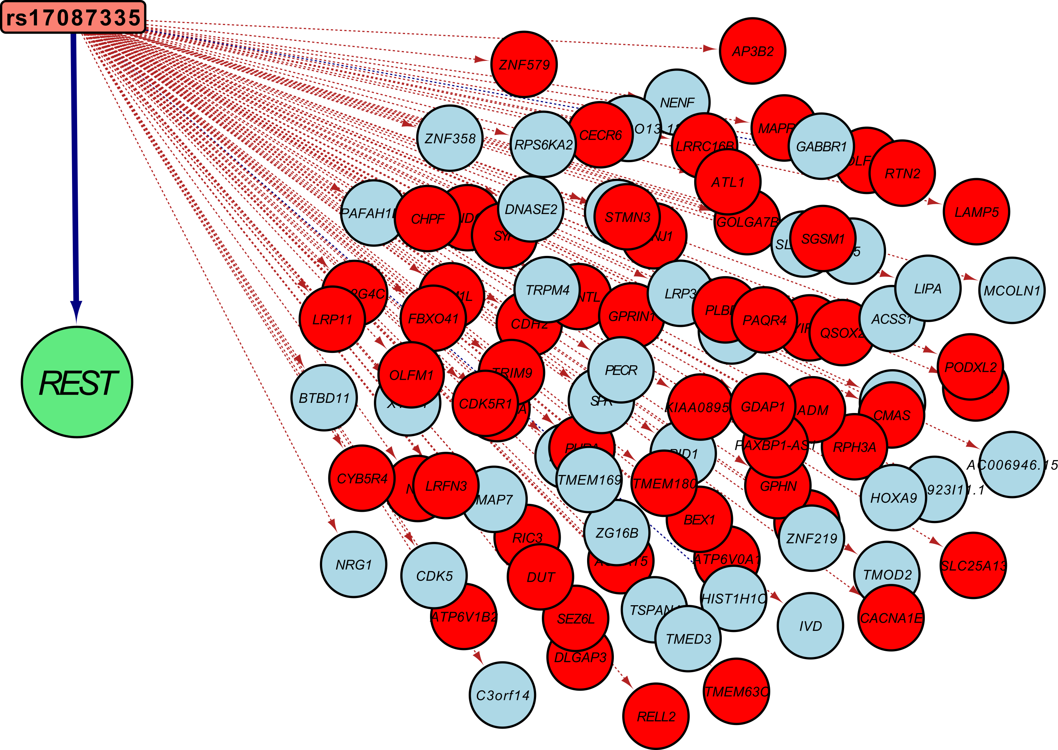
Trans-eQTLs can point to biological mechanisms
rs17087335
trans: 98%

Slide 32
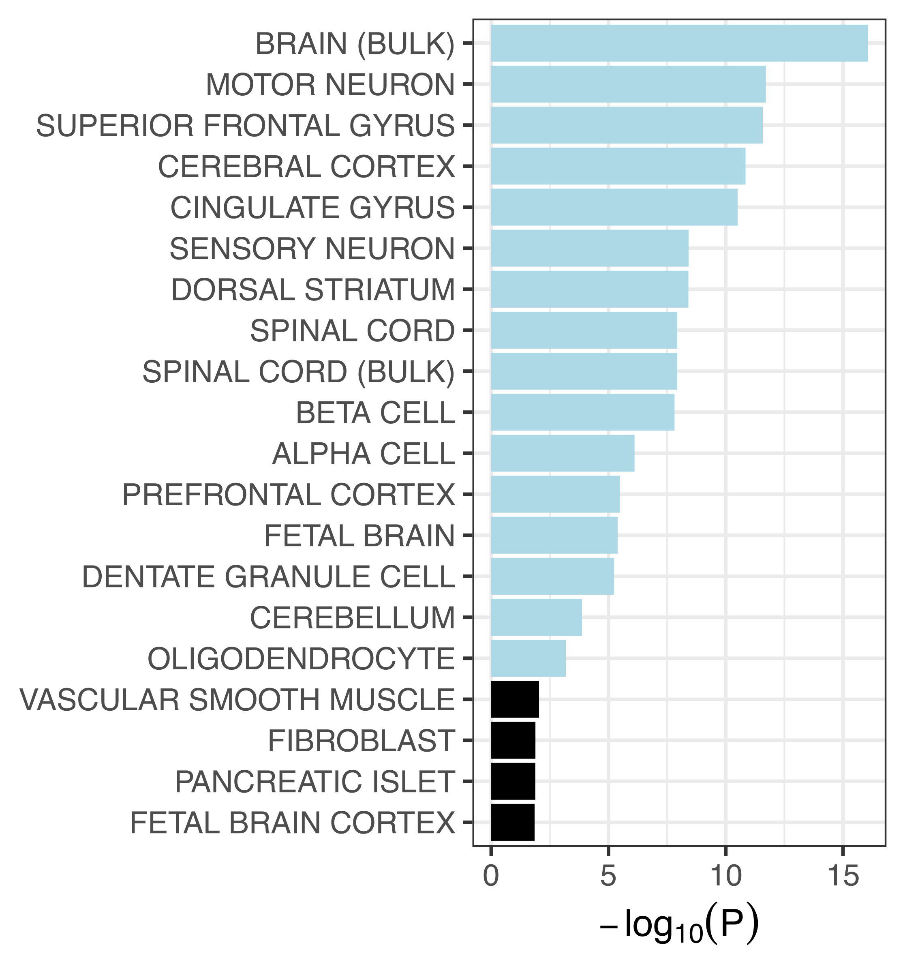
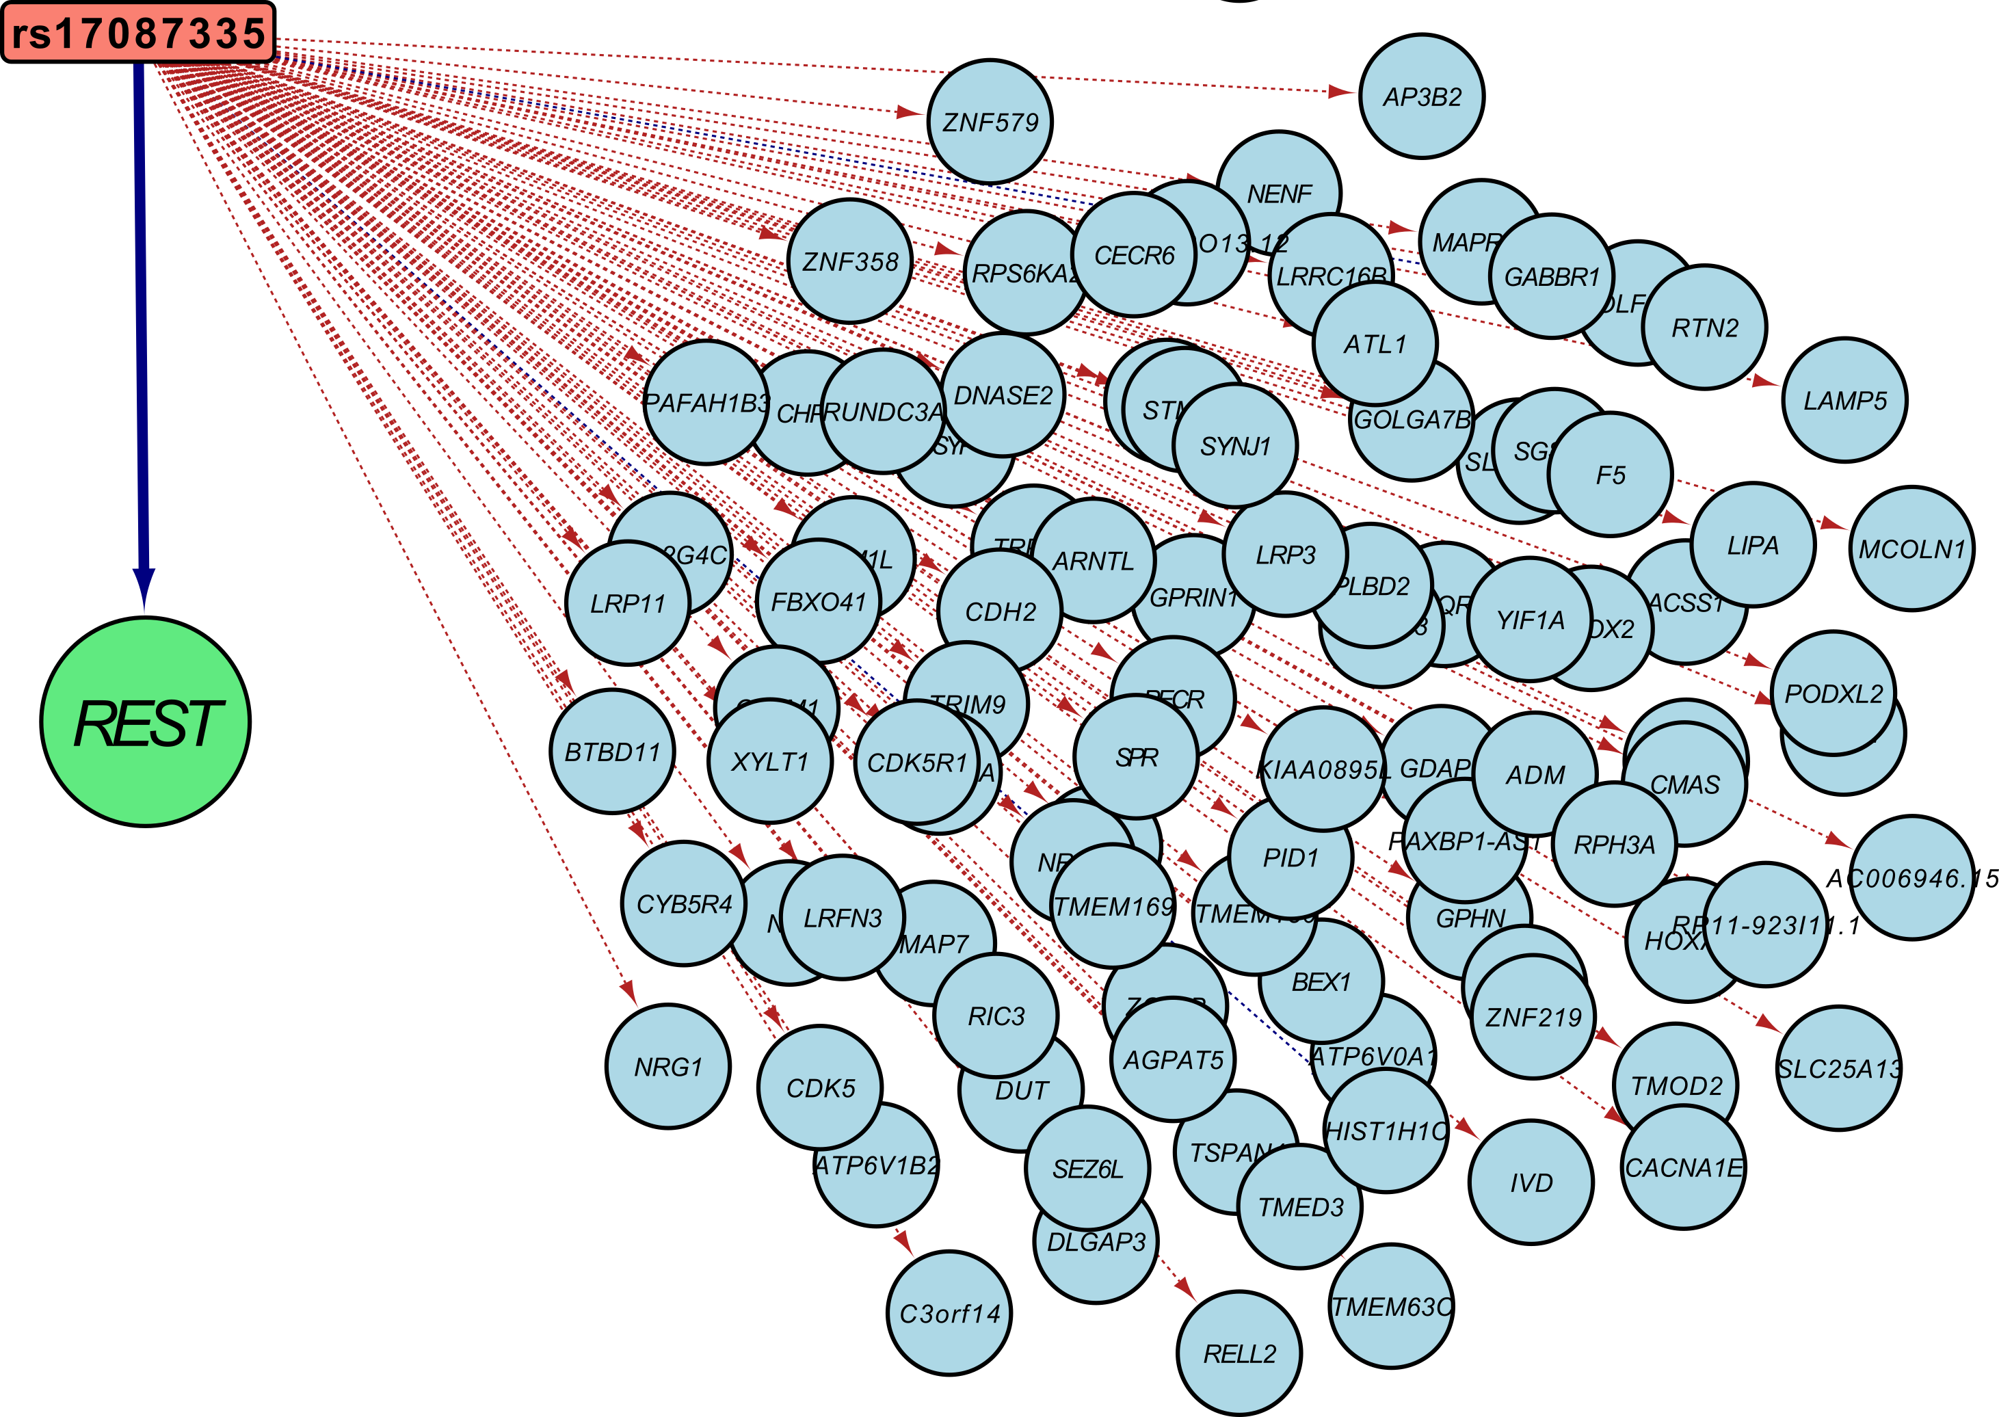
Trans-eQTLs can point to biological mechanisms
rs17087335
trans: 98%

Slide 33
Trans-eQTLs can point to biological mechanisms
rs17087335
REST- RE1 Silencing Transcription Factor
AKA
NRSF- Neuron-Restrictive Silencer Factor
trans: 98%

Slide 34
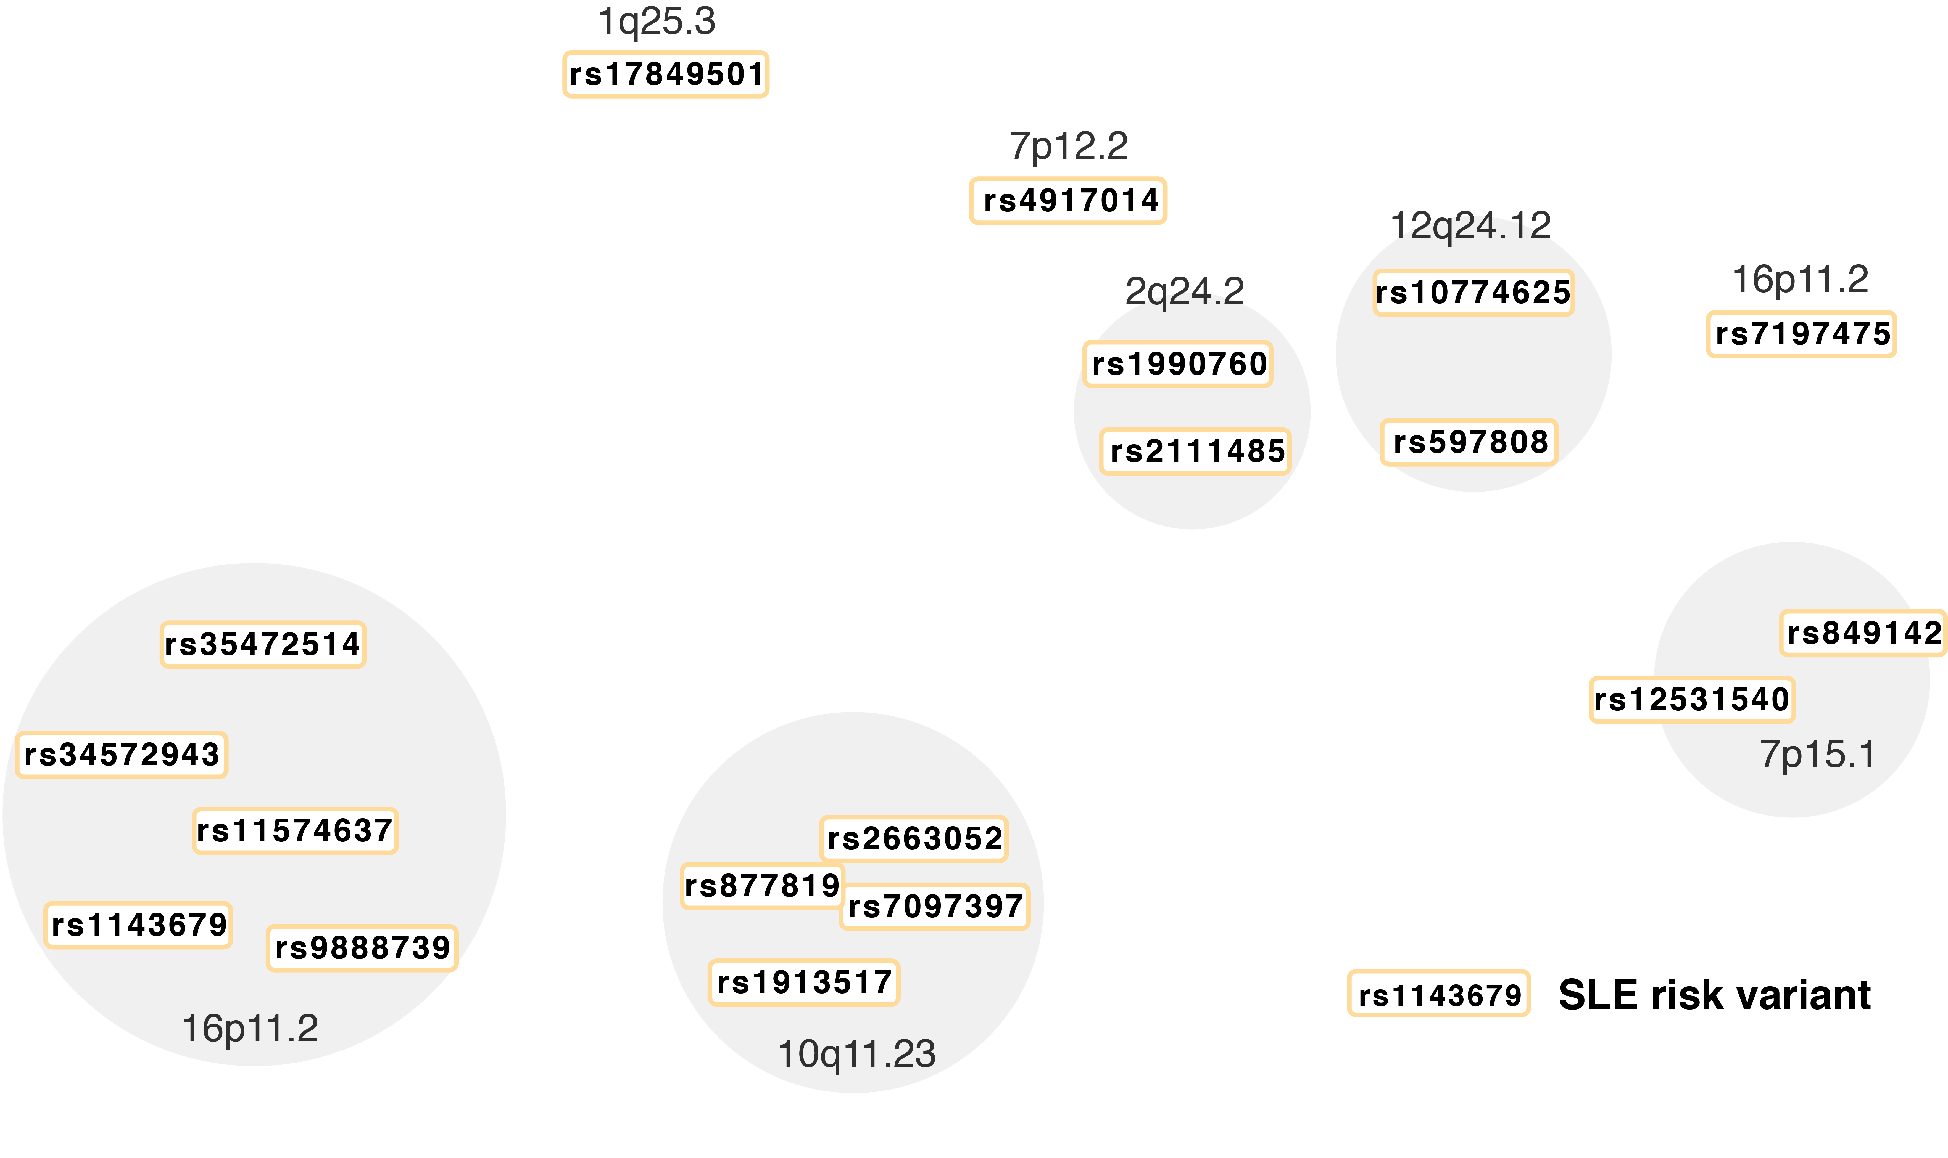
Trans-eQTLs converge on driver genes
Notes:
For example, these SNPs are all well-characterised SLE variants grouped by genomic location.

Slide 35
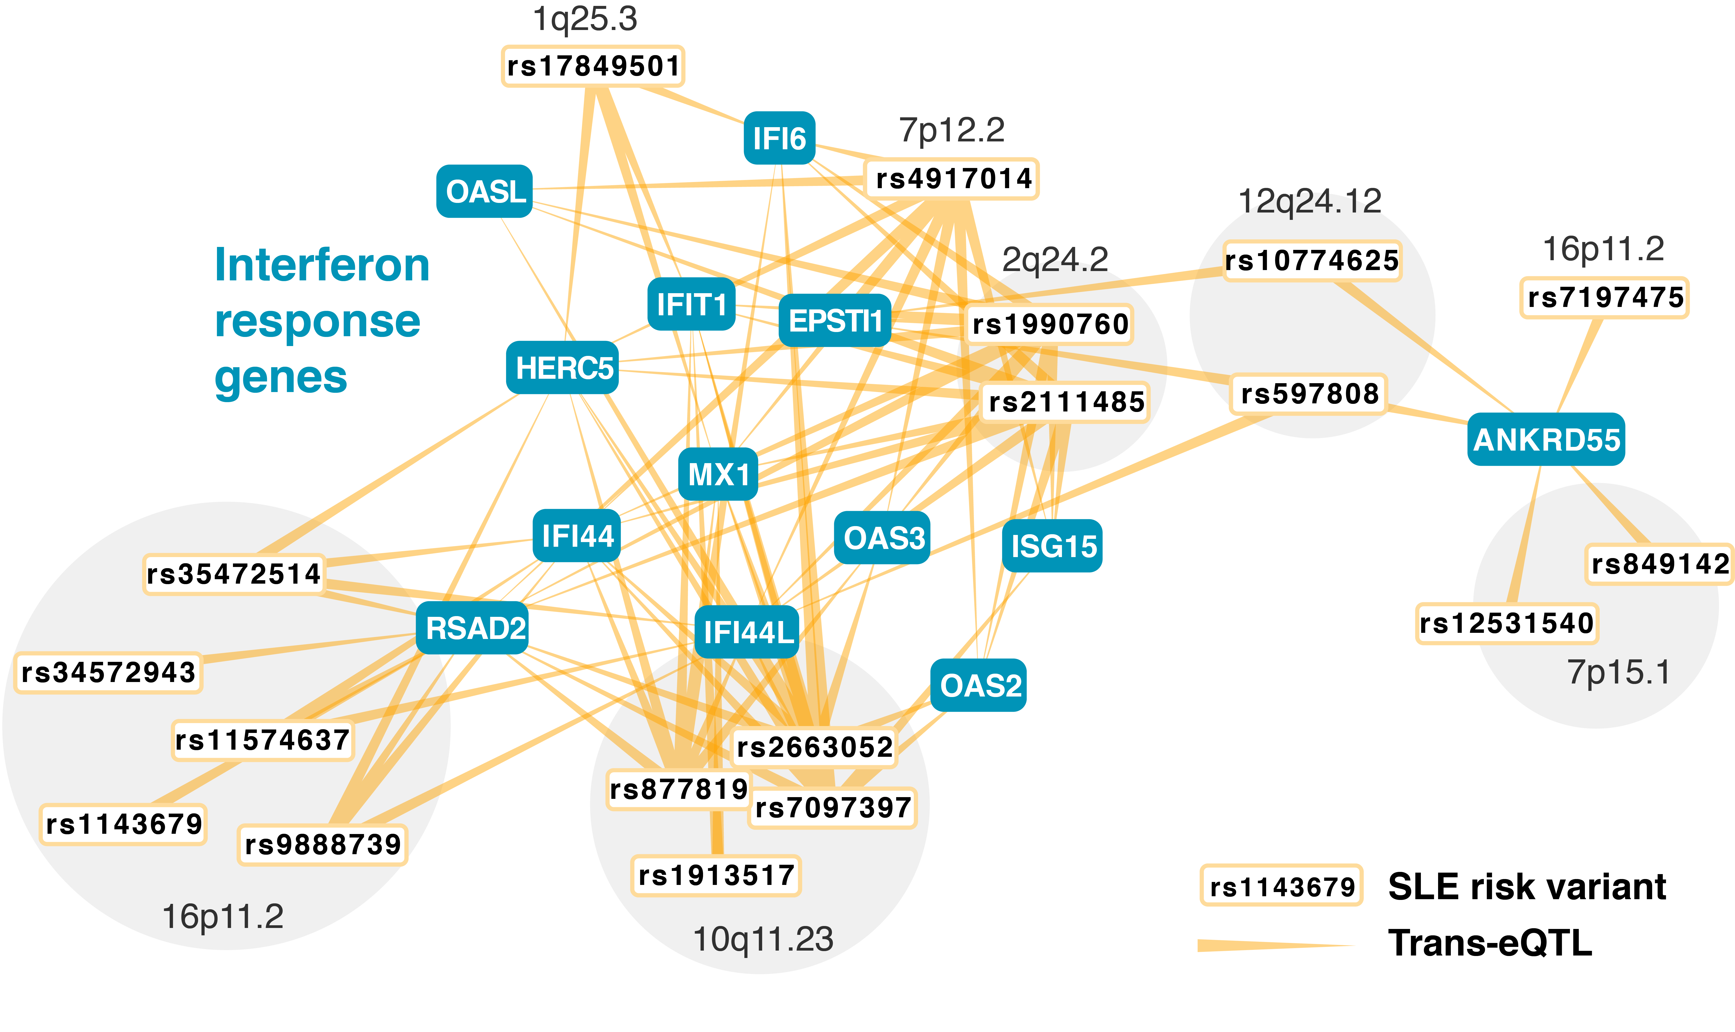
Trans-eQTLs converge on driver genes
Notes:
And if we look at the trans-eQTL results, we see that SLE risk loci converge on a set of key genes that are all part of the interferon response
Increased interferon signaling is a well-known hallmark for lupus patients, and the genes involved are highly co-expressed
Next question: can we identify other converging signals while taking direction of effect into account. If we combine genetic information from across the genome, we should be able to identify more of these kinds of key driver genes.

Slide 36
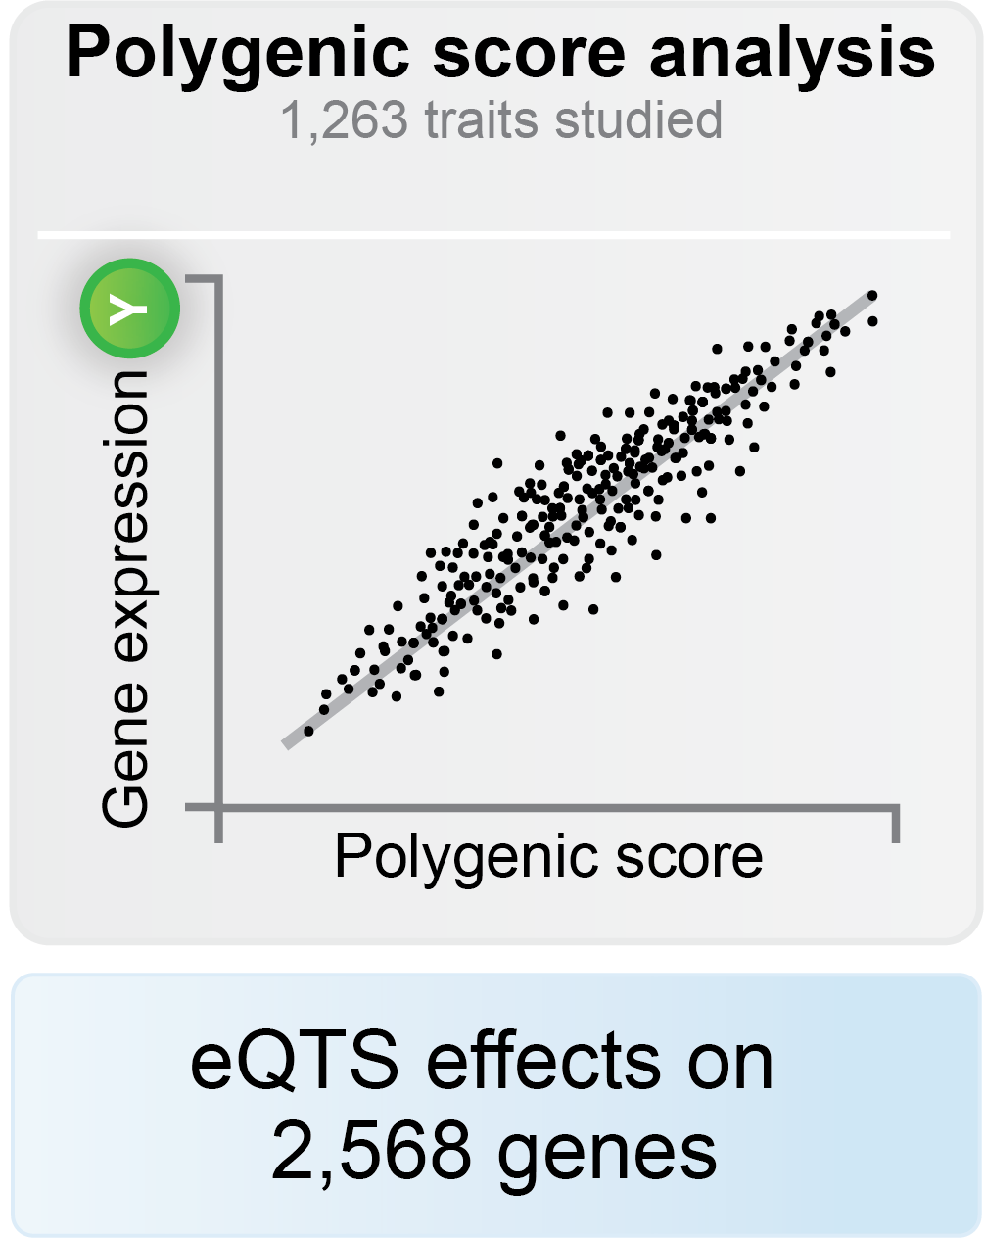
Combined genetic risk associates to gene expression
Notes:
Within eQTLGen we have assessed the association between combined genetic risk and gene expression.
We call this association eQTS - for expression quantitative trait score.
We calculated polygenic scores using the number and effect sizes of previously identified variants for 1263 traits for not only genome wide but also less significant loci and identified effects of polygenic scores on over 2.5k genes.

Slide 37
What is a polygenic score?
403 variants associated to type 2 diabetes
Polygenic scores for 1,263 traits and diseases
Alice
Bob
Carl
11 risk alleles
189 risk alleles
362 risk alleles
Notes:
Let’s recap what a polygenic score is with an example
We calculated these scores using the number and effect sizes of previously identified variants for 1263 traits for not only genome wide but also less significant loci

Slide 38
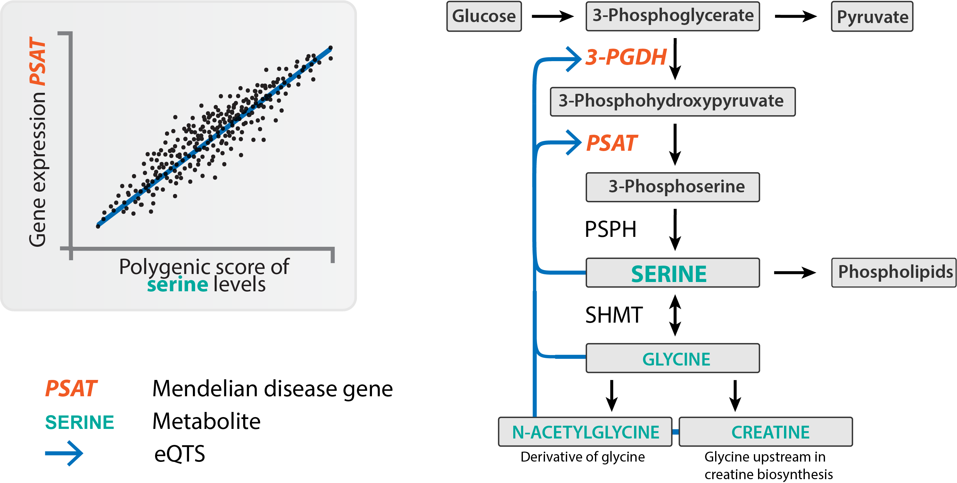
eQTS identify monogenic disease pathways
Notes:
One very striking finding is that eQTS associations can identify pathways involved in monogenic disease.
We calculated the polygenic score for the metabolite serine, where a high score means that you are genetically more likely to have high levels of circulating serine in your blood. We investigated in the eQTS analysis if the serine score associated to any gene expression levels, and it did, among others to PSAT. And that's interesting, because

Slide 39
eQTS identify monogenic disease pathways
Võsa et al., bioRxiv (2018)
Notes:
when you look at the serine biosynthesis pathway, you can see that both PSAT and 3-PGDH are key enzymes in the pathway.
These two genes are also known Mendelian disease genes causing neurological conditions if mutated.
We identified strong eQTS effects between the polygenic score of serine and other downstream metabolites, and the two key enzymes upstream in the serine pathway.
This example shows that eQTS can identify genes in well-defined pathways, known to be disrupted in monogenic disease, but apparently also regulated through common variation.
Neu-Laxova and phosphoserine aminotransferase deficiency

Slide 40
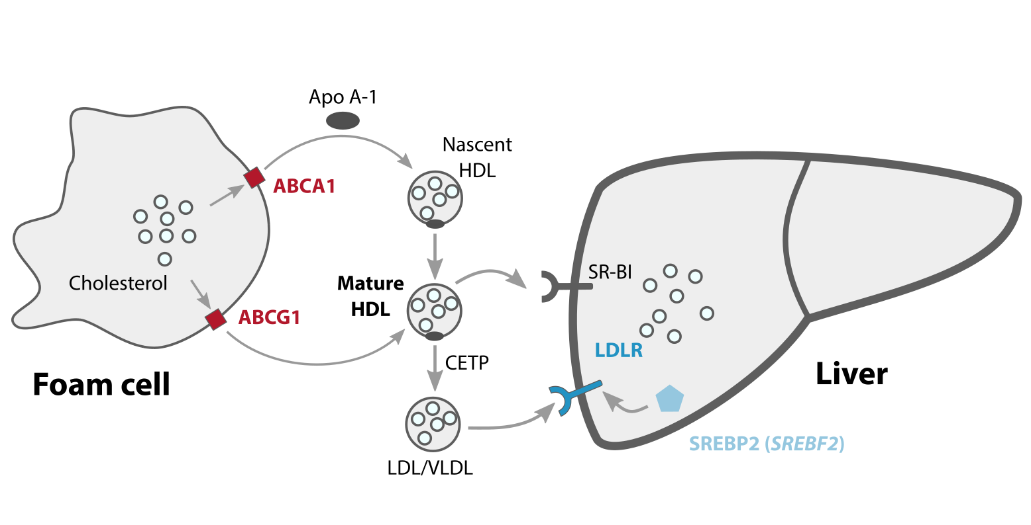
HDL risk associates with lipid genes
HDL eQTS
42% are lipid metabolism genes
Võsa et al., bioRxiv (2018)
Notes:
In another example, we calculated the PGS for HDL cholesterol, and found that 42% of the eQTS genes were previously associated with lipid metabolism.
Specifically, we identified the upregulation of ABCA1 and ABCG1 (ATP-binding cassette transporters), genes that mediate the efflux of cholesterol from macrophage foam cells. These genes also participate in HDL formation.
Another eQTS gene is SREBF2, a TF that upregulates LDLR. LDLR, another eQTS gene, is a receptor that takes up HDL.
This example shows that eQTS analysis identifies the genes we expect to play a central role in the phenotype of interest.

Slide 41
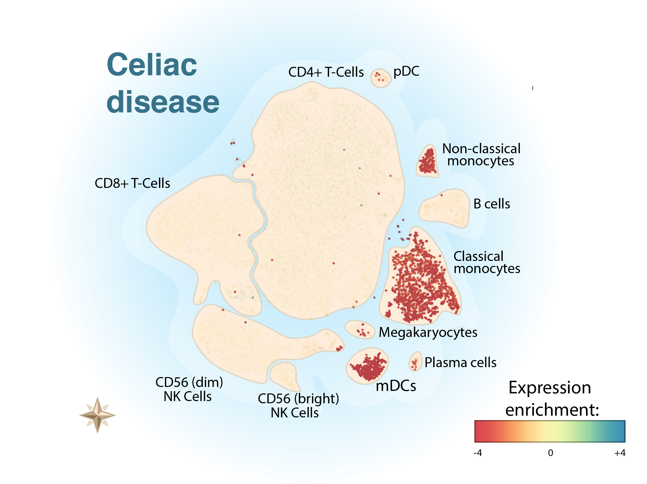
Immune traits manifest in specific cell types
Van der Wijst et al. 2018
Dubois et al. 2010
Trynka et al. 2011
Notes:
Last, we investigated some immune diseases, to see if there were any disease-specific signatures we could pick up
Here, we are looking at Celiac Disease eQTS results in single cell RNAseq data
Each island is a cell type, and each dot is a single cell.
The coloration indicates whether the eQTS genes identified for celiac disease are depleted or increased in these cell types
CeD genes are enriched in cytokine and interferon signaling
Those genes are depleted in monocytes and dendritic cells, and slightly enriched in T cells
That makes sense, because we know that T cells are involved in celiac disease

Slide 42
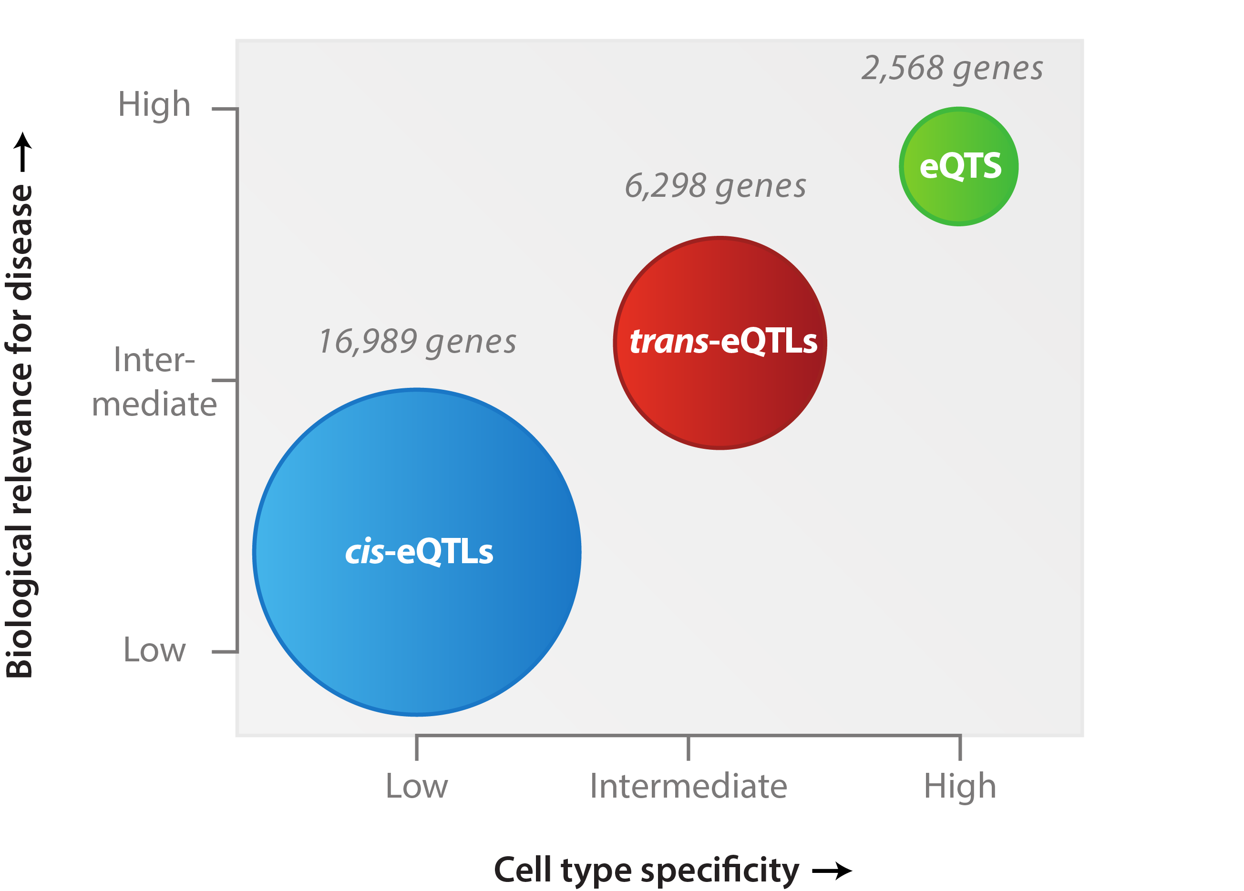
Concluding hypothesis
Võsa et al., bioRxiv (2018)
Notes:
I started this talk out with GWAS, and the reason for that is that we hope this type of work will bring greater value to disease associations. Based on the three analyses that we have performed, the cis-eQTLs, trans-eQTLs and polygenic risk analysis, we hypothesise the following:
Cis-eQTLs, local effects, are abundant, often shared between tissues and cell types, and especially these shared effects have limited use for interpreting complex traits.
Trans-eQTLs reflect more downstream consequences of genetic variation, and although we can identify fewer of them with the current sample size, we think there are many more of these effects out there, and they can often be used to gain new biological insight.
Last, eQTS, where we look at the combination of genome-wide risk for a disease, are even harder to identify, and seem to reflect almost entirely blood-related biology. However, we do identify very likely key driver genes for immune, metabolic and lipid pathways, leading us to believe that this type of combined genetic risk analysis is worthwhile. I would like to stress here that this is a concluding hypothesis, and we need more samples as well as other tissue resources to really put it to the test.

Slide 43
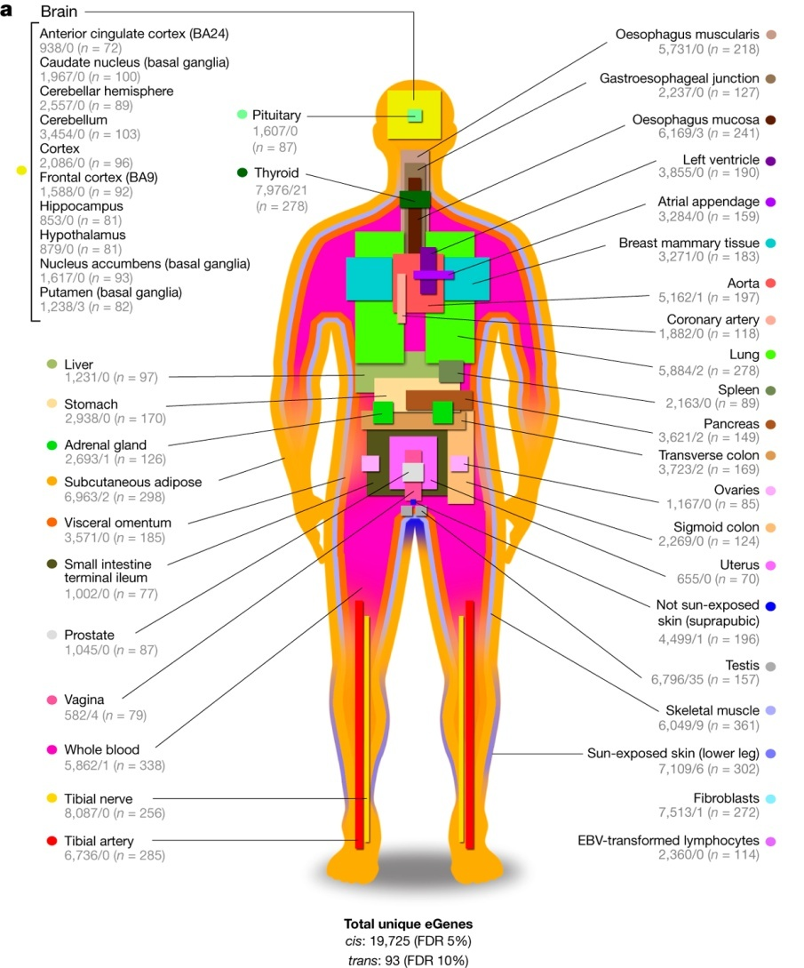
GTEx
Genotype-Tissue Expression
Post-mortem samples
44 tissues
70-361 samples per tissue
GTEx Consortium, Nature (2017)

Slide 44
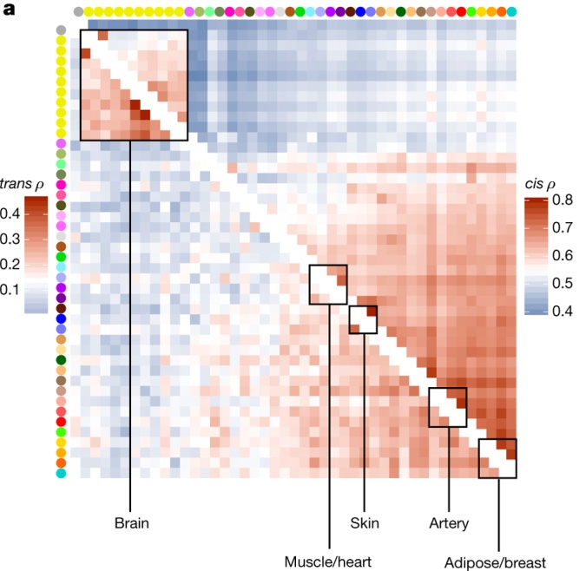
Sharing eQTLs across tissues
GTEx Consortium, Nature (2017)
Notes:
Note the slightly misleading gradient

Slide 45
Investigating common vs. rare diseases
Common complex diseases
Many common genetic variants
>50% of variants affect gene expression
Rare monogenetic diseases
Single rare genetic variant
Focus on protein coding variants

Slide 46
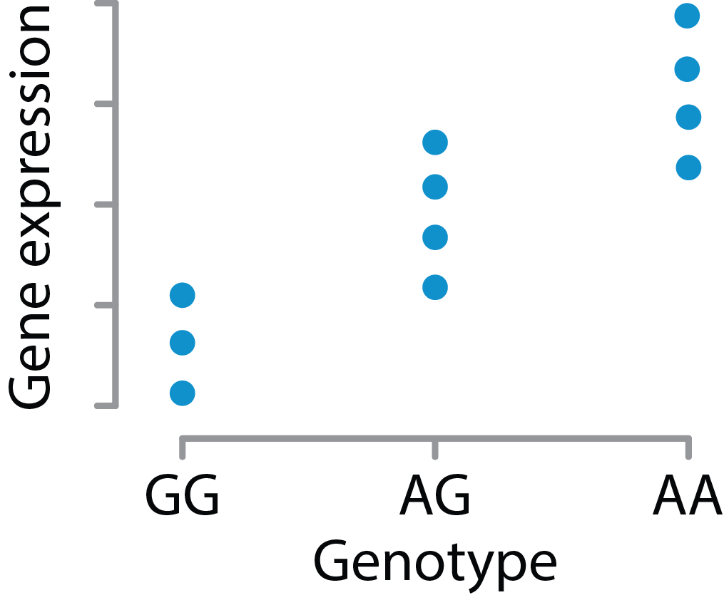
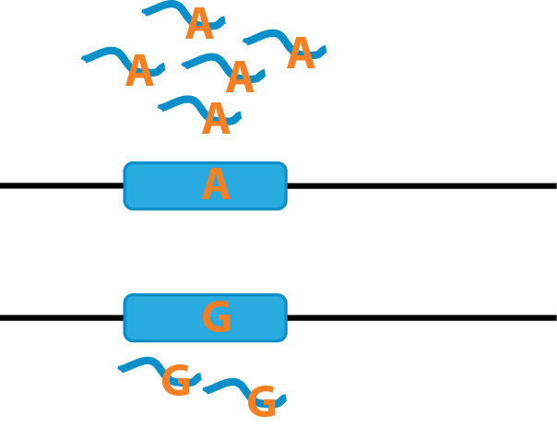
Investigating common vs. rare variants
Expression Quantitative Trait Locus
Correlation between genotype and expression
Common variants
Allele Specific Expression
Imbalance in expression
Rare variants

Slide 47
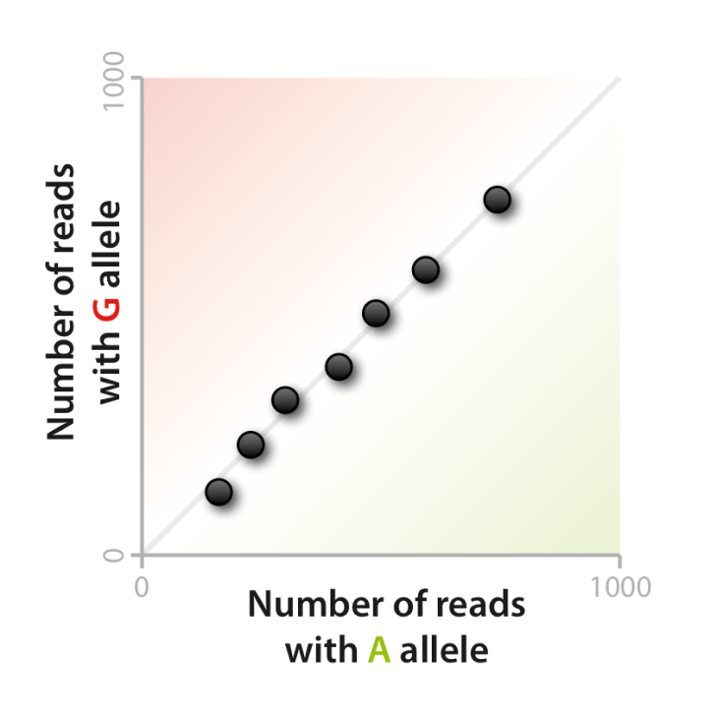
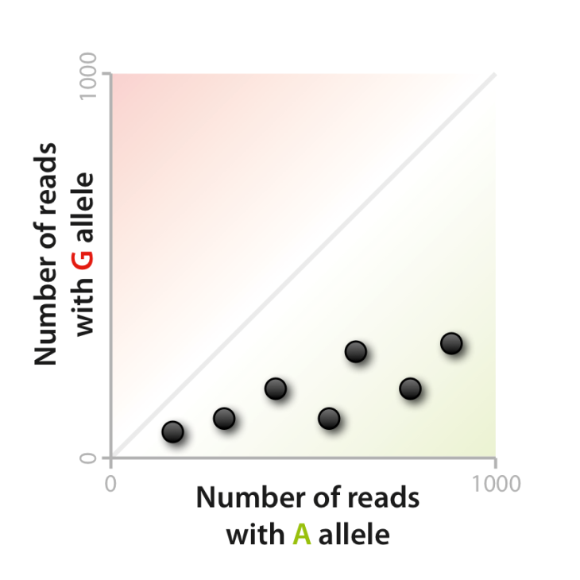
Allele Specific Expression (ASE)
Alleles equally expressed
Bias towards A allele

Slide 48
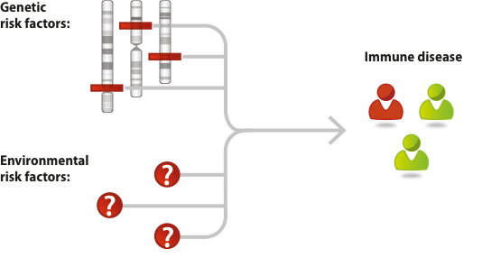
Interplay of genetic & environmental risk factors unknown
>10,000 known,
But small effects
Mostly unknown,
Viruses / bacteria implicated

Slide 49
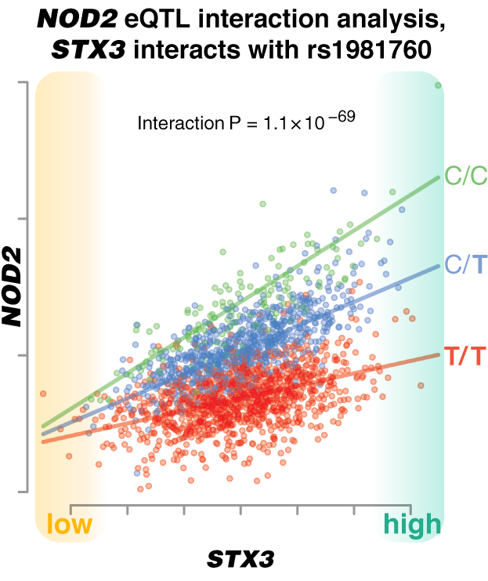
Detecting cell type dependent eQTLs in whole blood
Zhernakova et al., Nature Genetics (2016)

Slide 50
meQTLs
eQTLs
pQTLs & mQTLs
miQTLs
GWAS

Slide 52
DNA methylation
DNA methylation is an extra methyl group to a C nucleotide
Like other epigenetic features, it can be influenced by both environment and genetic factors
Highly methylated DNA is more tightly packed and therefore cannot be accessed by the gene expression machinery

Slide 53
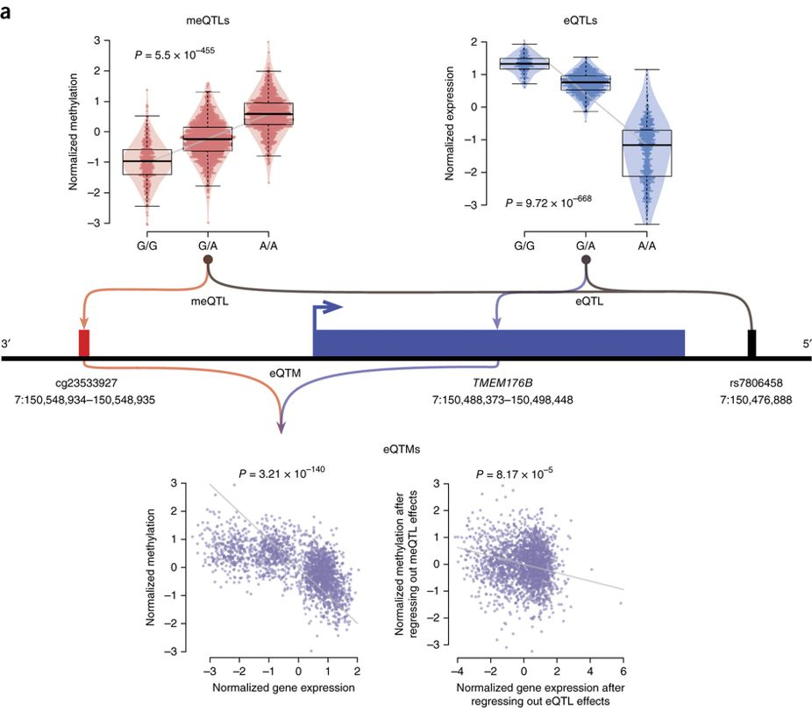
meQTL
eQTL
eQTM
where methylation level influences gene expression level
Bonder et al.,
Nature Genetics (2017)
Notes:
Integrating multiple data layers gives new insights, for example here they found that 1/3 of known GWAS variants have some effect on methylation, so it is clearly an important mechanism for regulation from GWAS variant to phenotype. But using these three layers together, also indicates that our understanding becomes more complex immediately. There is a lot of buffering ongoing!

Slide 55
40% of cis pQTLs were eQTLs for the same gene
Sun et al.,
Nature (2018)
Notes:
A missense variant (rs28929474:T) in SERPINA1 was associated with 13 proteins at P < 1.5 × 10⁻¹¹ and a further six at P < 5 × 10⁻⁸ (Fig. 2). This variant (the ‘Z-allele’) results in defective secretion and intracellular accumulation of α1-antitrypsin (A1AT), an anti-protease. Individuals homozygous for the Z allele have a deficiency of circulating A1AT and an increased risk of emphysema, liver cirrhosis and vasculitis.
Integration with expression data shows that 40% were found as eQTLs.. You would expect all of them to be present, right? Again demonstrates the level of buffering and complexity of these systems

Slide 57
Protein CNTN1 associates to both genetics and microbiome
Zhernakova et al., Nature Genetics (2018)
Notes:
Both the genotype (C/C, T/C, T/T) and the microbiome here influence the level of protein level CNTN1. Chorismate biosynthesis is a pathway that multiple bacteria together are involved in.
“Chorismate is a precursor for tryptophan, which can be further converted to serotonin. Ninety percent of tryptophan is synthesized in the gastrointestinal tract and it is considered a key signaling metabolite between the gut and the CNS”
a, Trans-pQTL effect of CNTN1 at SNP rs61261356 in the TMEM8A/AXIN1 locus. b, Association between plasma level of CNTN1 and the bacterial chorismate biosynthesis pathway. c, Genetic–microbiome interaction in CNTN1. Association strength between CNTN1 and chorismate biosynthesis is different and significantly lower in homozygous individuals.

Slide 58
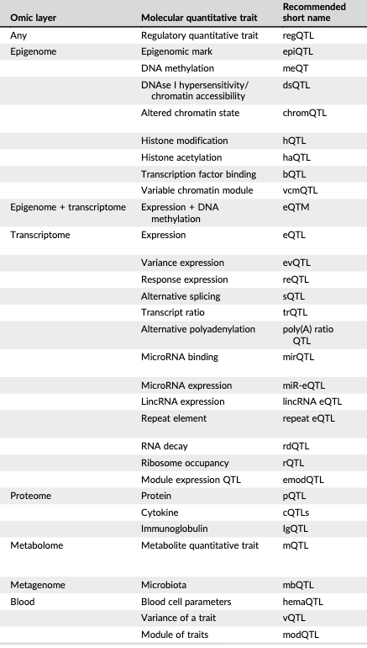
Quantitative trait loci exist for many more layers of omics data
Meaningful integration is key
Vandiedonck,
Clin. Genetics 2017

Slide 59
Conclusions
Genetic variants on their own are informative, but no immediate biological understanding
Increasingly more molecular data layers (‘omics’)
Fundamental understanding of omics and their interplay crucial to understanding disease
Genetic & molecular profiling in your doctor’s office

Slide 60
Resources to do GWAS follow-up
LocusZoom: http://locuszoom.org/
To make zoomed in plots of region of interest
LD link: https://ldlink.nci.nih.gov/
To assess linkage disequilibrium between SNPs (how tightly SNPs are linked)
UCSC genome browser: https://genome-euro.ucsc.edu/index.html
To see location of SNPs and genes, very customizable
GWAS catalog: https://www.ebi.ac.uk/gwas/
To view and download known GWAS associations from many traits
eQTLGen: https://eqtlgen.org/
To view and download cis- and trans-eQTLs from eQTLGen
BIOS eQTLs & meQTLs: https://genenetwork.nl/biosqtlbrowser/
To view and download cis- and trans-eQTLs & meQTLs from BIOS
FUMA: https://fuma.ctglab.nl/
Integrated suite to interpret GWAS summary statistics using many tools and datasets
Gene atlas: http://geneatlas.roslin.ed.ac.uk/
To identify other traits associated with your SNP of interest

